Slide 1
GEORGIA TQIp collaborative sneak peek: the new data submission reports
Amy Svestka, BA, EMT, CSTR
Program Manager, TQIP Data Quality
American College of Surgeons, Committee on Trauma

Slide 2
2018 NTDS DATA DICTIONARY
Change Date | Admission Year | Field Name | Change Location | Change Text
Jul-17 | 2018 | Hospital Complications | Additional Information | Removed: For all Hospital Complications that follow the CDC definition [e.g., VAP, CAUTI, CLABSI, Osteomyelitis] always use the most recent definition provided by the CDC.
Jul-17 | 2018 | Appendix 1: Facility Dataset | Retired
Jul-17 | 2018 | Appendix 1: Acount Center | New

Slide 3
Good afternoon,
We would like to remind all participants of the Trauma Quality Programs (NTDB, TQIP, and Verification) about the opening of our new Participant Hub and Account Center!
The Participant Hub is your new point of access for participation in the Trauma Quality Programs (TQP). From the Participant Hub, you will access the Account Center to manage facility and contact information, and request a Verification site visit. TQIP participants will also be able to access TQIP training materials from the Account Center.
We ask that you please visit the Account Center to review the contacts and facility information we have for your trauma center and make updates as needed. Please note that only the Data Primary Contact at your facility will be able to add or delete contacts. We will be opening the call for data soon, and want to be sure all information on our new Account Center is accurate for you and your facility.
To log in to the Account Center, please use the username provided below. If you are a current TQIP Participant, your username and password are the same as those you currently use to access TQIP Education on the TQIP Education Portal.
Username: XXXXXXXX
If you do not know, or have forgotten your password, please use this link to reset your password.
Please be sure to contact us with any questions at TraumaQuality@facs.org.
Best regards, Your Trauma Quality Programs Staff

Slide 4
Coming soon

Slide 5
Submission Reports…
Updated to allow an interactive user experience
Clickable fields that provide record level data
Clickable pie graph depicting validation levels
Ability to convert tables to PDF and/or Excel

Slide 6
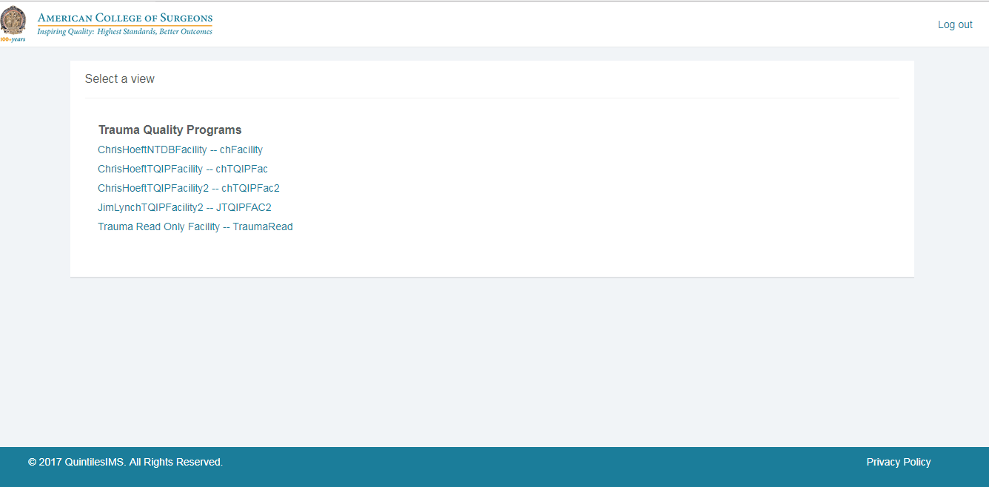

Slide 7
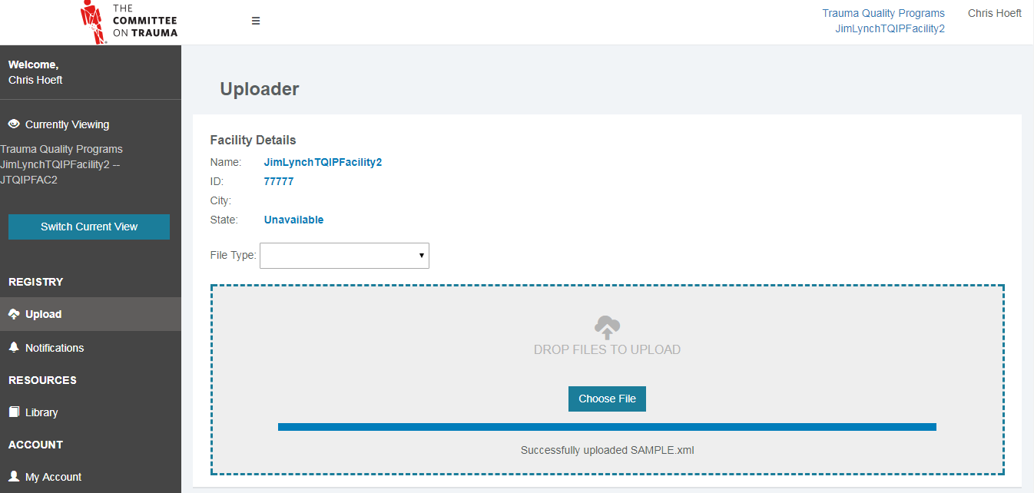

Slide 8
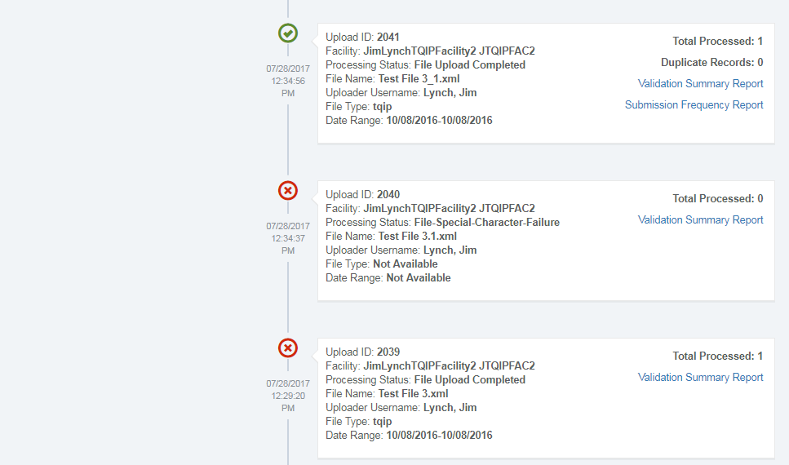

Slide 9
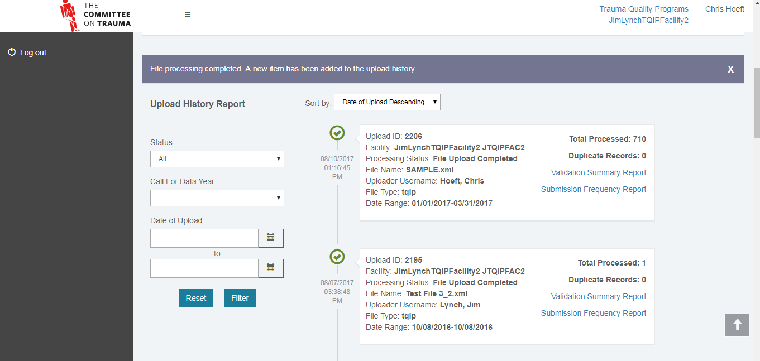

Slide 10
Validation Summary Report

Slide 11
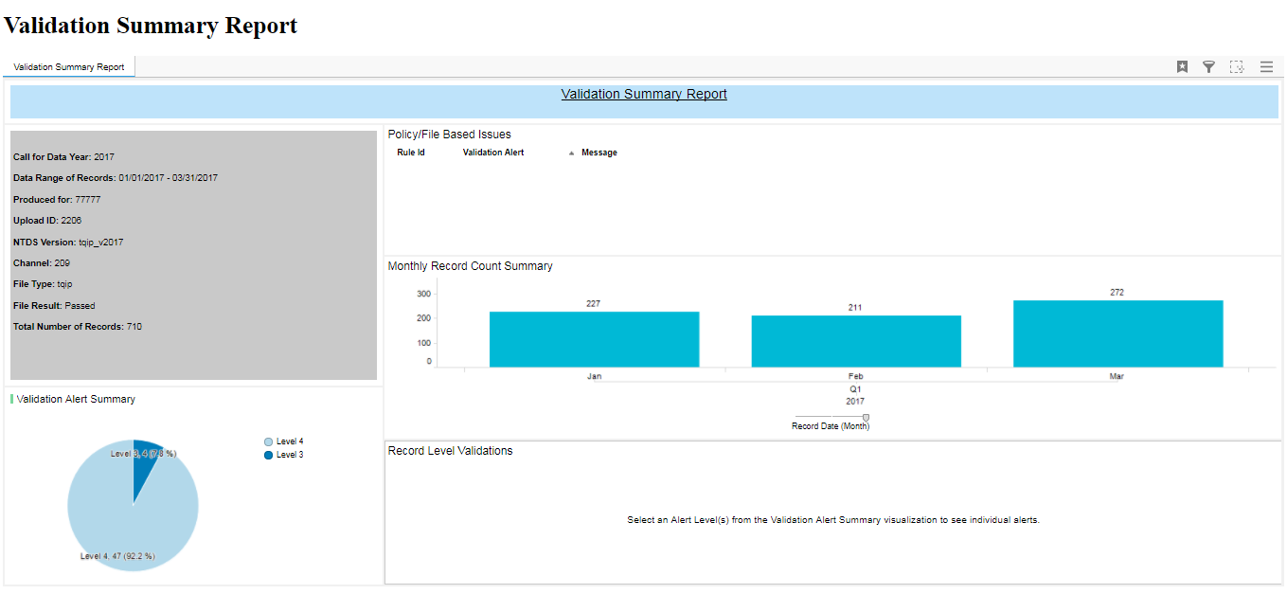

Slide 12
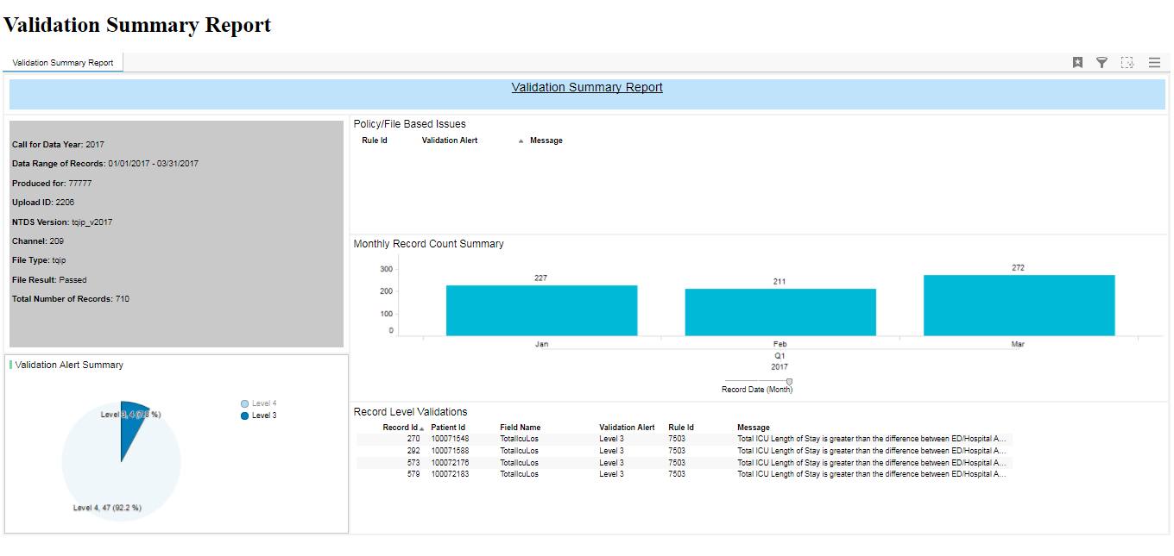

Slide 13
The new Submission frequency Report features

Slide 14
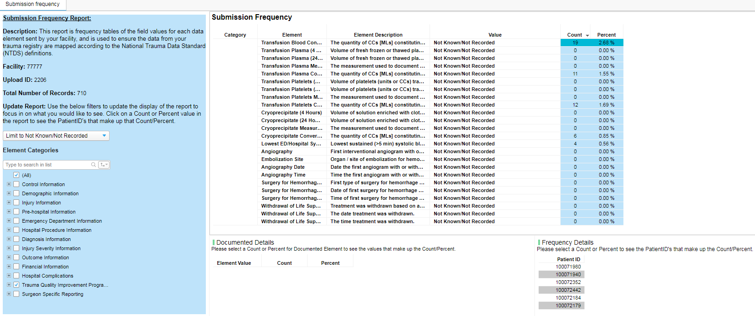

Slide 15
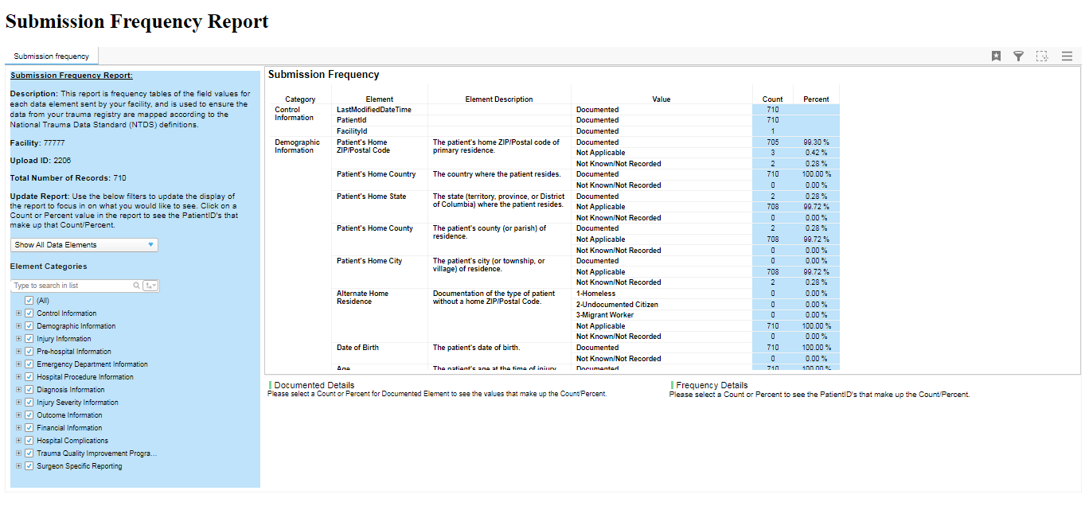

Slide 16
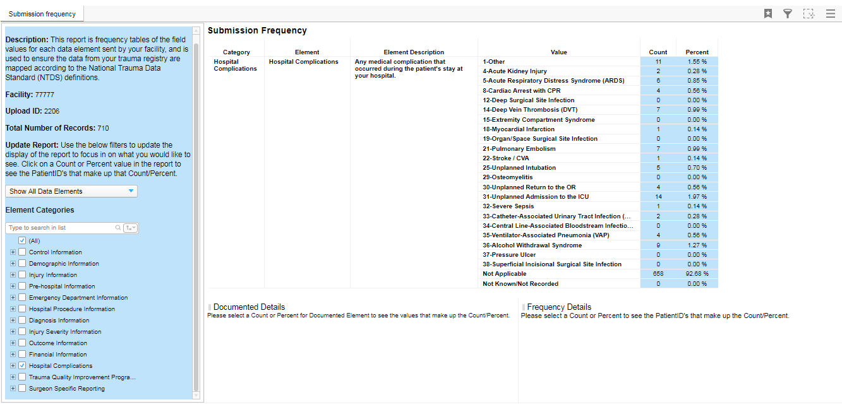
Percent of patients in the file with that specific complication

Slide 17
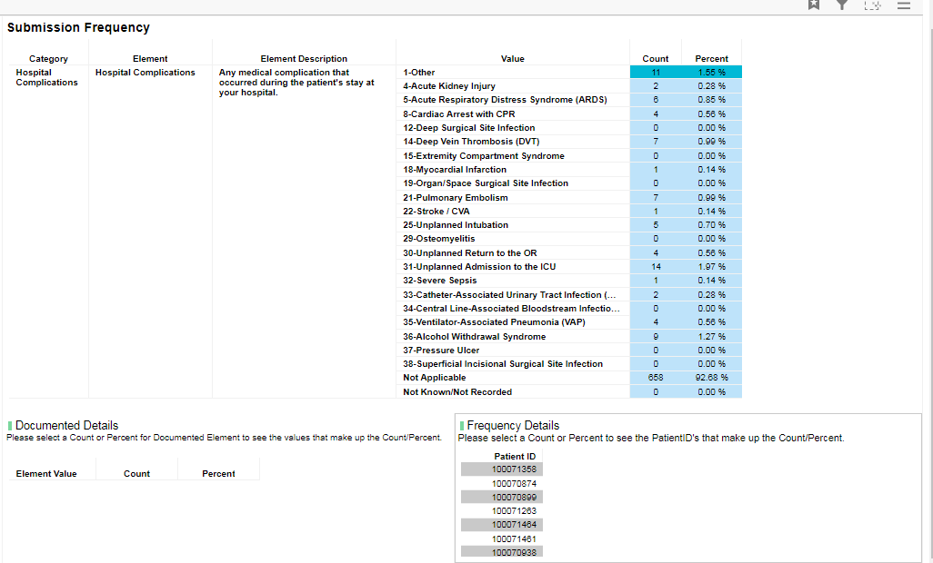

Slide 18
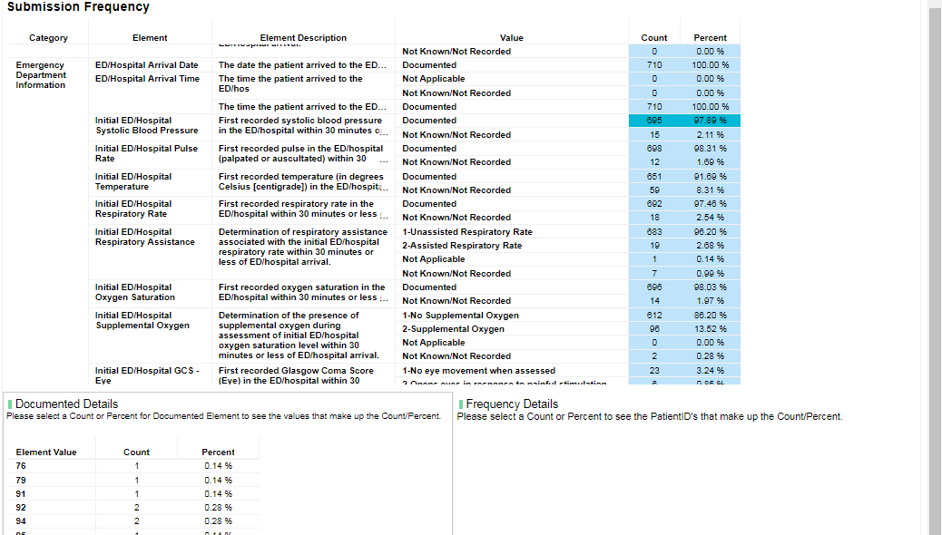

Slide 19
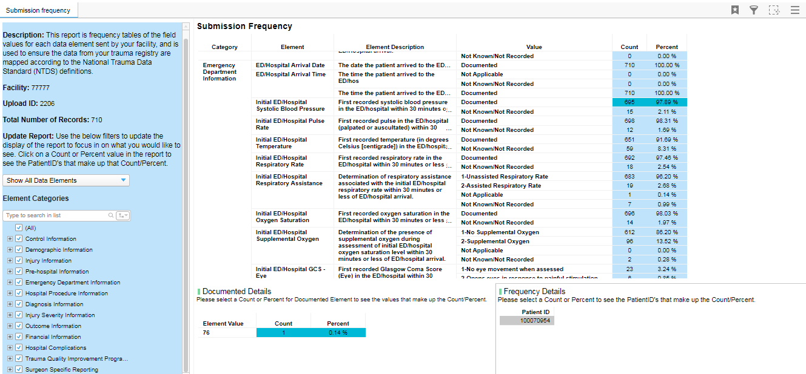

Slide 20
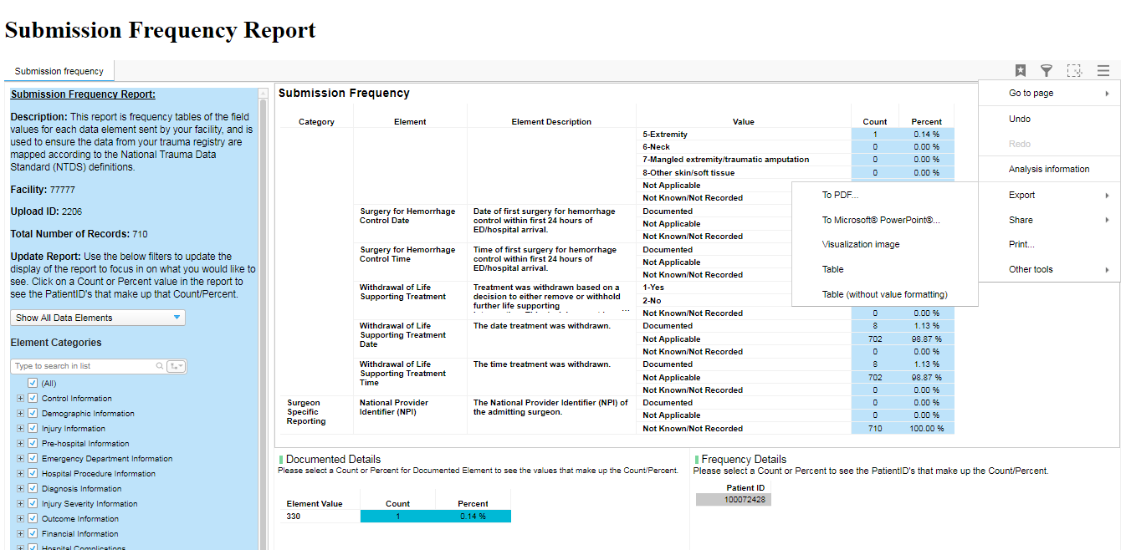
Converting Tables to PDF & Excel

Slide 21
interpreting the new Submission frequency Report

Slide 22
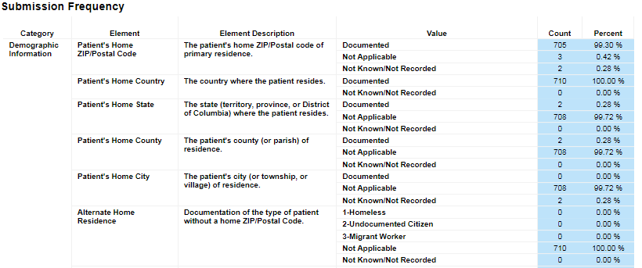
Demographic Information
Patient’s Home State, County, City, Alternate Home Resident should only be reported to the NTDB if Patient’s Home Zip/Postal code is “Not Known/Not Recorded”
Is the Patient’s Home City reported correctly?
Is the Alternate Home Residence mapped correctly?

Slide 23
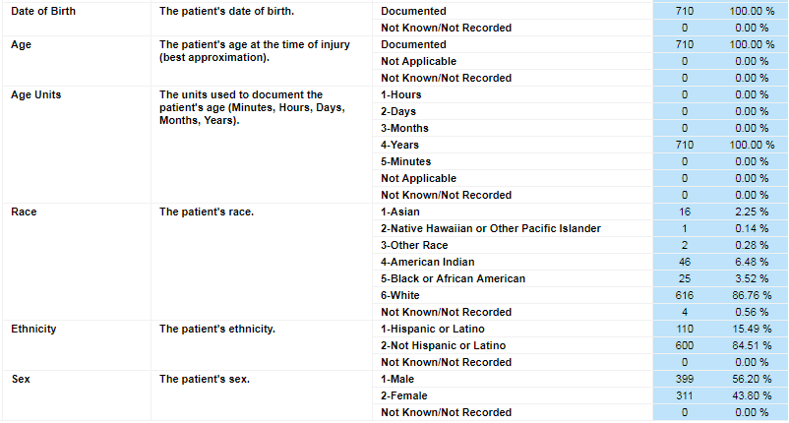
Demographic Information
Patient’s Age and Age Units are only reported to the NTDB if Date of Birth is “Not Known/Not Recorded”

Slide 24
Injury Information
Patient’s Occupational Industry is only reported to the NTDB if Work-Related is “YES”

Slide 25
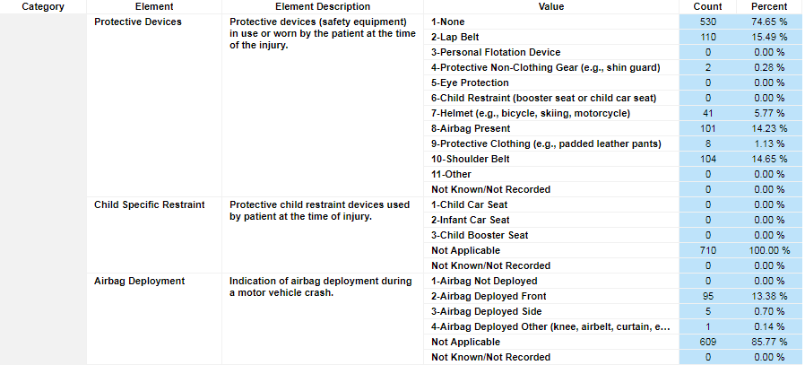
Injury Information
If “Child Restraint” is reported to the NTDB as a Protective Device, Child Specific Restraint should also be reported
If “Airbag Present” is reported to the NTDB as a Protective Device, Airbag Deployment should also be reported
Total Airbag Deployment could be greater than total Airbag Present

Slide 26
Injury Information
Investigation of Physical Abuse and Caregiver at Discharge are only reported to the NTDB if there was a Report of Physical Abuse.

Slide 27
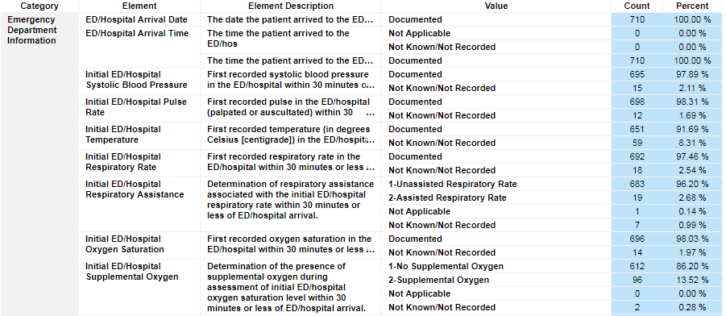
Emergency Department Information
Respiratory Assistance is only reported if Respiratory Rate is reported.

Slide 28
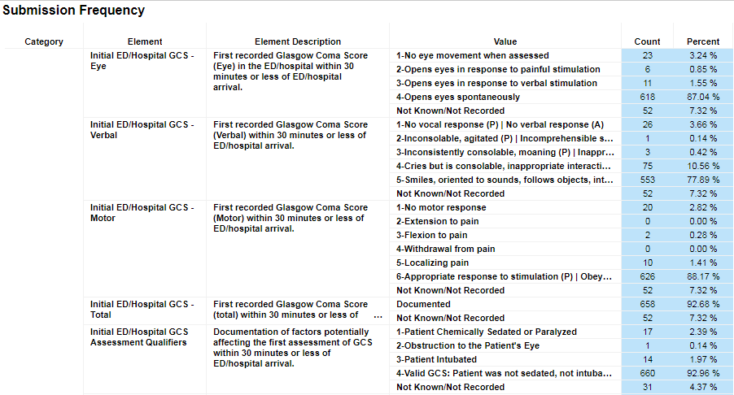
Emergency Department Information
Does the data make clinical sense???

Slide 29
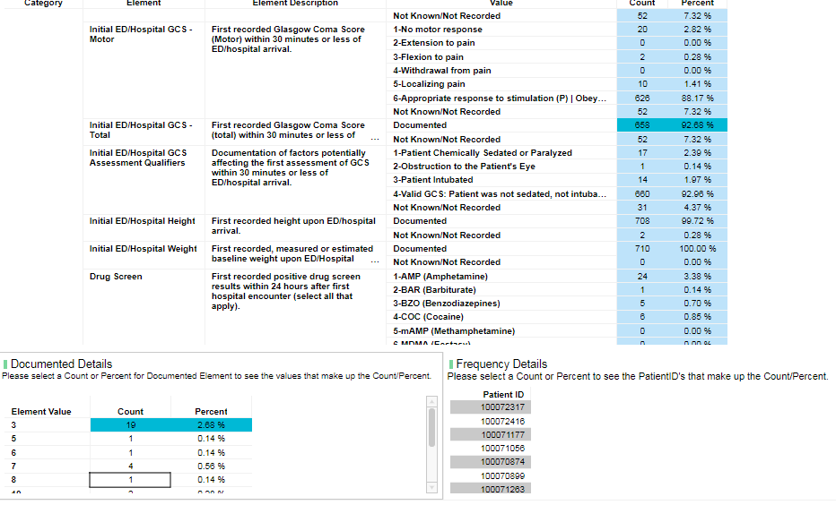

Slide 30
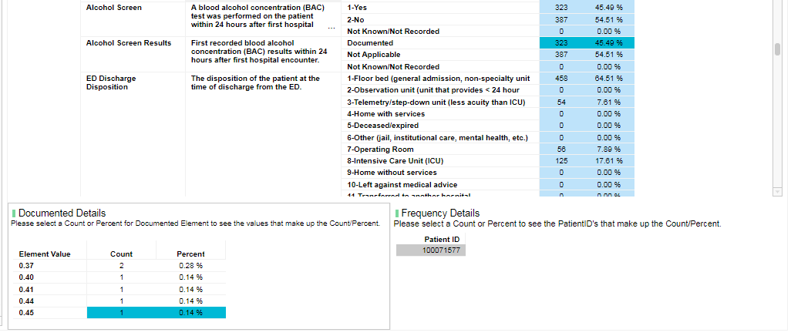

Slide 31
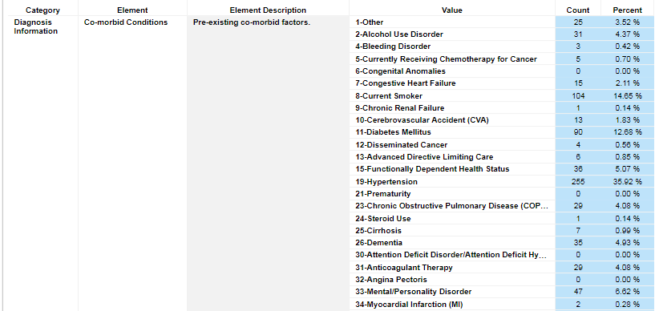
Diagnosis Information
Does the data make clinical sense???

Slide 32
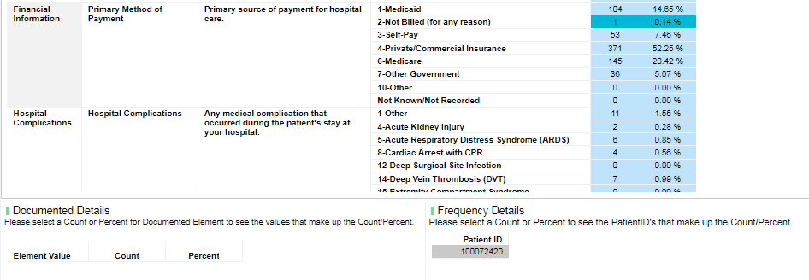
Financial Information

Slide 33
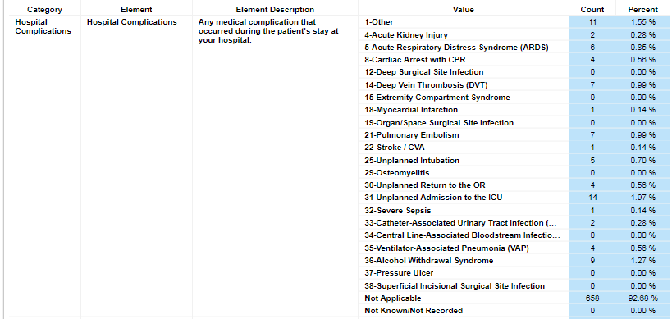
Hospital Complications
Is there a mapping problem ???

Slide 34
Measures for Processes of Care
Does the data make clinical sense???

Slide 35
Measures for Processes of Care
Cerebral Monitor could be greater than Cerebral Monitor Date/Time

Slide 36
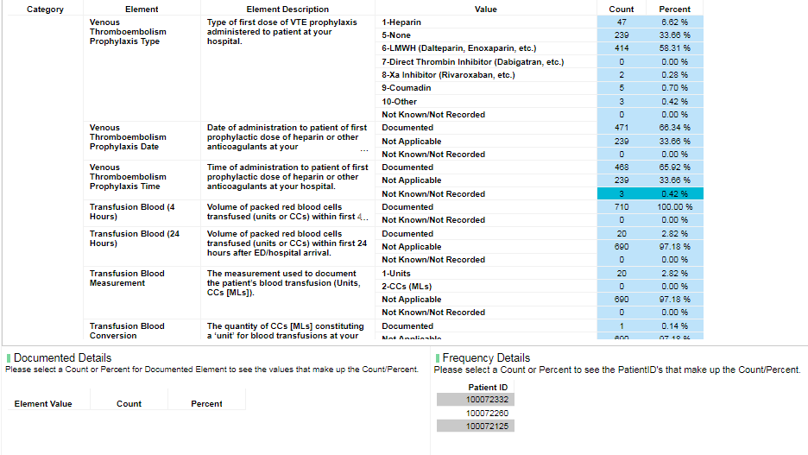
Measures for Processes of Care

Slide 37
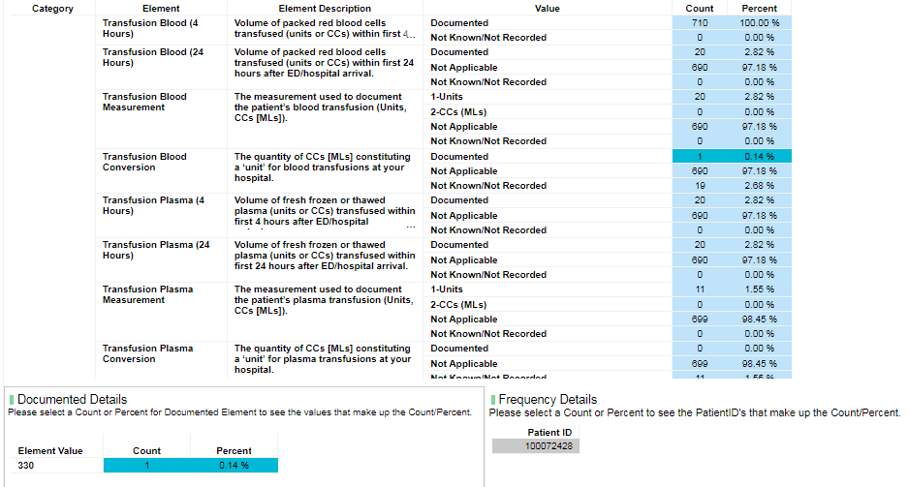
Measures for Processes of Care

Slide 38
Measures for Processes of Care
Is this a mapping problem?

Slide 39
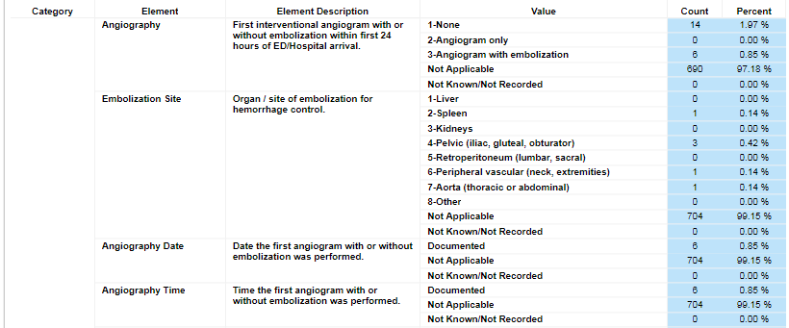
Measures for Processes of Care

Slide 40
Business intelligence (BI) tools

Slide 41
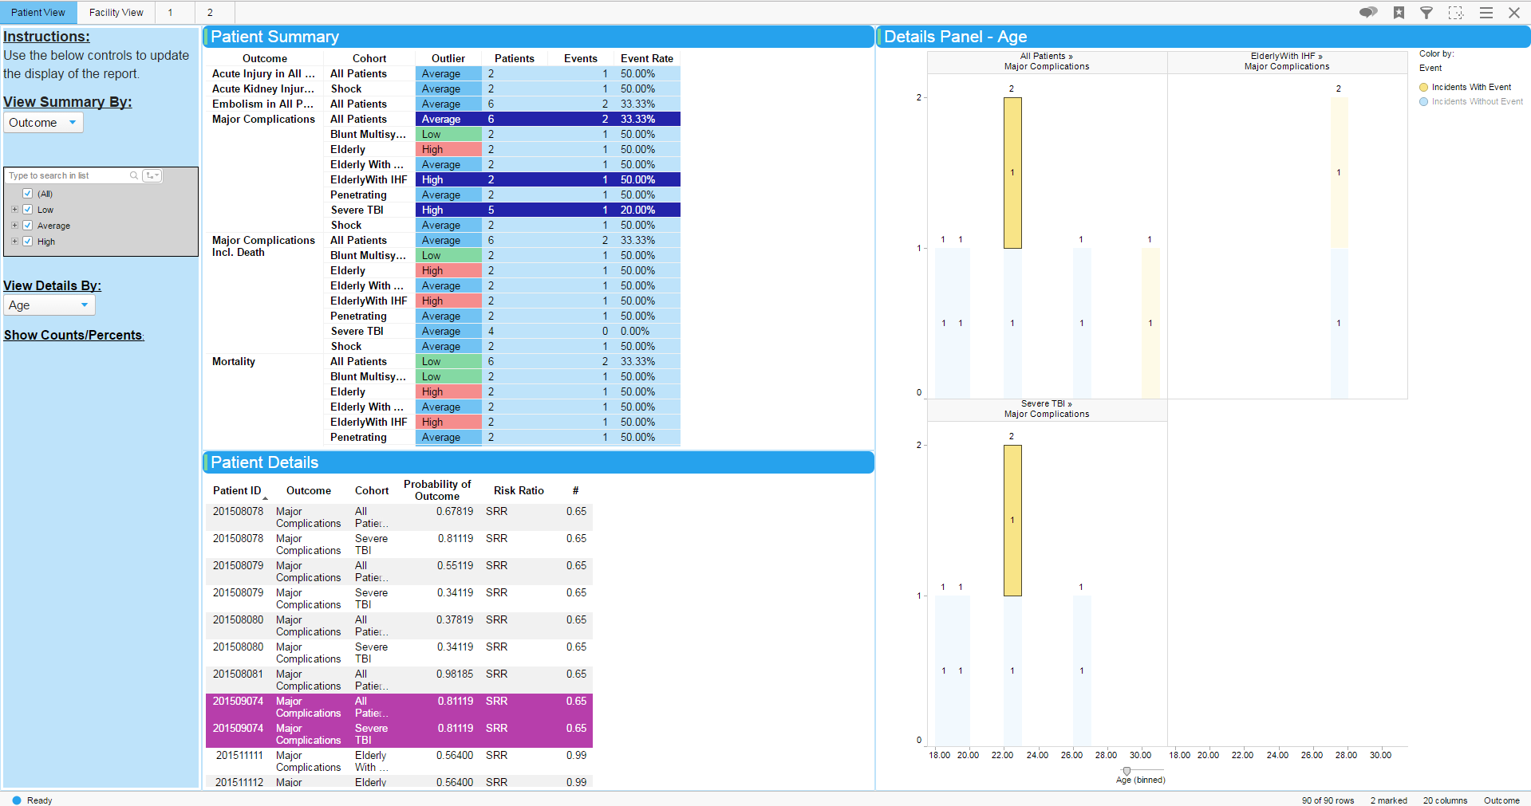
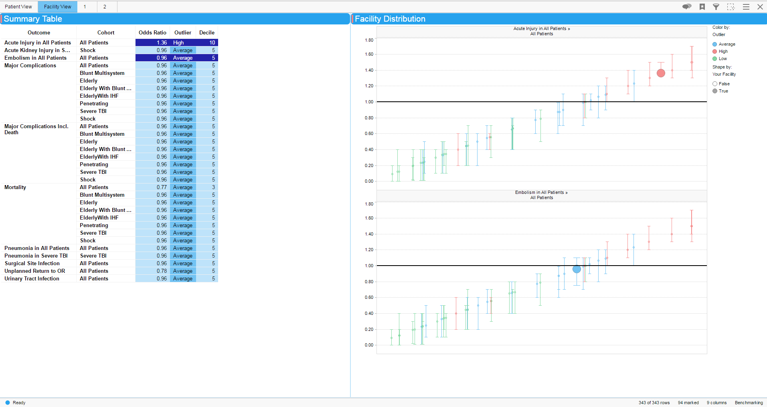
Modernized
Slicker user experience
Interactive
Clickable charts drilling down into patient lists
Exportable
Capacity to export all data in reporting period
Visual
Graphic depictions of outlier status and caterpillar figures

Slide 42
??? QUESTIONS ???

