Slide 1
GCTE PI SUBCOMMITTEE GERIATRIC TRAUMA
BEST PRACTICES, TQIP AND CURRENT LITERATURE
OCTOBER 9, 2019
Discussion lead by:
Jesse Gibson, MBA, BSN, RN, TCRN,
Trauma Program Manager, Northeast Georgia Medical Center
Anastasia Hartigan, MBA, BSN, RN, TCRN, CEN VP Trauma Doctors Hospital

Slide 2
Relevance of Geriatric Trauma
The 2010 U.S. Census estimated those of age >65 to be 13% of the total population and projected by 2020 this would increase to 22%
Baby boomers are “booming” with a life expectancy of 78.2 years
In 2009, elderly trauma patients made up 30% of trauma admissions at Level I and Level II trauma centers
In 2014, National Trauma Data Bank (NTDB) data showed injury from falls exceeded injury from MVC or any other mechanism as the mechanism of injury leading to hospitalization
We must address this population aggressively

Slide 3
Review of the Literature

Slide 4
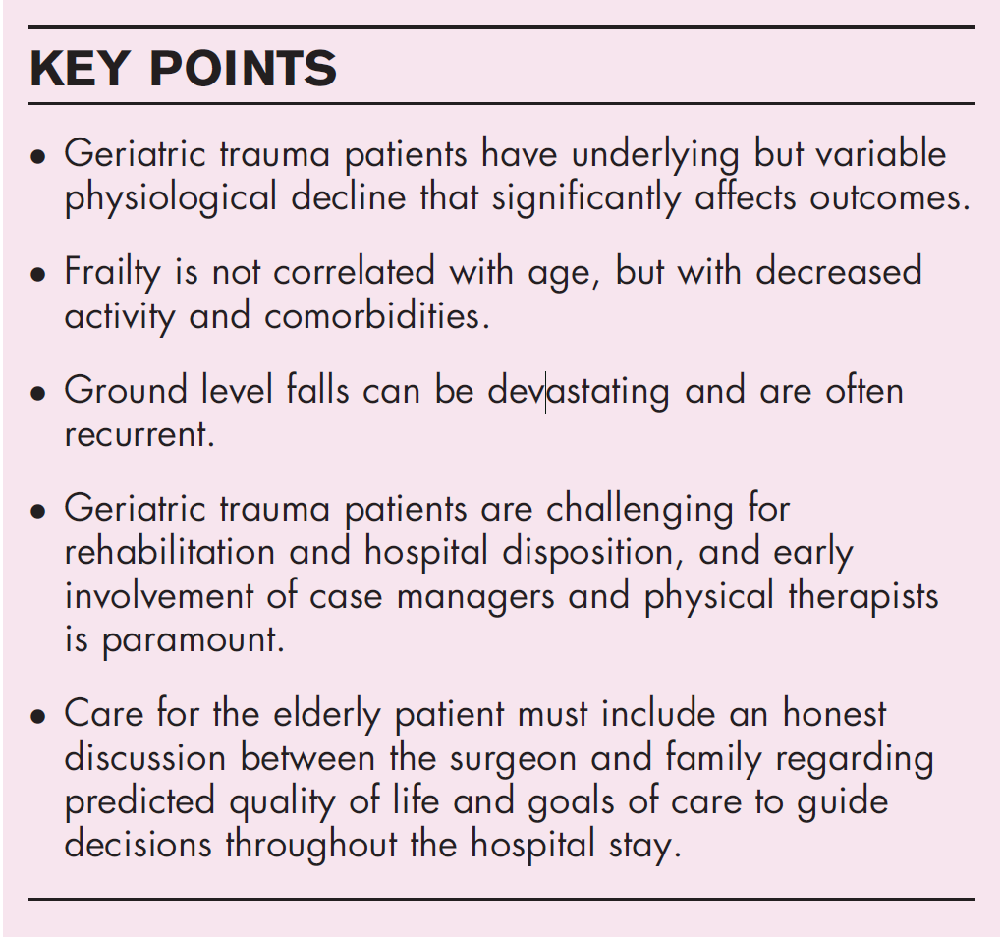
Review of the Literature
Triage- identifying key criteria and key destination
Frailty- identifying frailty and understanding the extended risks
MOI- although falls are the most common, elderly patients are sustaining other mechanisms as well.
Trauma is the 5th leading cause of death in the elderly
Anticoagulant use
Traumatic brain injury

Slide 5
Review of the Literature
Lower threshold for trauma activation
Elderly patients with at least one body system with an AIS score of 3 or higher or a base deficit of -6 or less should be treated at a trauma center
If on anticoagulants, an appropriate assessment of coagulation profile and CT brain should occur as soon as possible
If > 65 with GCS < 8 and no substantial improvement within 72 hours of injury, consider limiting aggressive therapeutic interventions.

Slide 6
Review of the Literature

Slide 7
Review of the Literature
UK Trauma Protocol Manual: Geriatric Trauma Guideline
Secondary should emphasize the following:
Determine medications that affect initial evaluation & care
Consider acute, non-traumatic events that could complicate presentation
Lab assessment
Imaging
Anticoagulant assessment & reversal
Specialized inpatient geriatric care- comprehensive geriatric assessment
Patient decision-making capacity & care preferences
Discharge
Predicting outcomes

Slide 8
TQIP Guideline Breakdown
Trauma Team Activation recommendations
Trauma activations
Imaging
Anticoagulation reversal
Initial Evaluation recommendations
Medication/Medical history
Lab recommendations
Anticoagulant reversal section is out of date regarding reversal agents available
Specialized inpatient care recommendations:
Adopting the Beers Criteria
Patient family involvement and decision making recommendations
Discharge planning

Slide 9
Now On to the PRQ and monitoring your Geriatric Population
Recommendations

Slide 10
PRQ Question 1:
Geriatric Trauma Admissions, (age 65 or >) during the reporting year:
Injury Severity and Mortality:
Include isolated hip fractures from same level falls and/or fall from standing height, if these patients are captured in the trauma registry* and are used towards the Trauma Admission volume and in the data tables as noted in Section II of the PRQ.
Do not include isolated hip fractures from same level falls and/or fall from standing height, if these patients are not captured in your registry.
* The admission inclusion criteria/policy for elderly patients is set by each trauma center
ISS | (A)Total Number of Trauma Admissions | (B)Total Number of Trauma Deaths | Percent Mortality (B over A x 100) | Number Admitted to Trauma Service | Number Admitted to Other Surgical Services | Number Admitted to Non-Surgical Services
0-9
10-15
16-24
>or=25
Total

Slide 11
PRQ Question 1 DI V5 Report:
PRQ Report: PRQ_ISS_GerIATRIC (di v5)
Generated Report

Slide 12
PRQ Question 2:
From the total number of geriatric trauma patients admitted (column (a) from table), the number of patients admitted after a fall from standing height, excluding patients with isolated hip fractures.
Were all patients in table 1 reviewed by the TPM and TMD for appropriateness of admission and other opportunities for improvement? (Yes/No)
Have documentation available at the time of the site visit labeled as attachment 16­1.
Ideas for demonstrating this attachment?

Slide 13
PRQ Question 3-5:
Does the hospital have an end of life policy for patients? (Yes/No)
Do you have geriatric trauma guidelines or performance improvement projects? (Yes/No)
If 'Yes', please describe: (PRQ Example
Geriatric trauma guidelines have been developed by the best practice committee and adopted by the TQMPIPS committee. The guidelines provide guidance for triage and care of the geriatric patient age 65 and older and specific injuries and comorbidities that put the patient more at risk for complications and increase mortality. Assessment indicators are included to guide the provider to the resuscitation endpoints appropriate for this population. Adjusted doses for RSI medications are included in the guidelines as well.
Do you have a geriatric­ trauma unit in your hospital? (Yes/No)
If 'Yes', please describe:

Slide 14
PRQ Question 6-8:
Do your nurses caring for geriatric trauma patients receive any geriatric trauma training? (Yes/No)
If ‘Yes’, please describe:
Are patients with isolated hip fractures included in your registry data? (Yes/No)
If ‘Yes’, # of admissions: # here
Describe the hospital’s policy for admission of patients with isolate hip fracture: (PRQ example)
The trauma center admission decision tree requires the trauma surgeon to be consulted on patients with hip fractures. The patient can be admitted to the trauma surgeon or orthopedist with hospitalist consulting. The Trauma Multidisciplinary PIPS committee is currently reviewing hip fracture guidelines that specify directions for surgical clearance and evaluation. All admissions to non-surgical services are reviewed through the PI process and taken to the appropriate level of review for necessary loop closure.
Discussion point

Slide 15
Hip Fracture Repair Timing
TQIP standard to repair within 48 hours of arrival
Current literature supports repair within 24-48 hours depending on source
to decrease morbidity and mortality
Encourage early ambulation
Decreased length of stay
TQIP Guidelines met if repaired within 48 hours

Slide 16
Hip Fracture PI, What’s happening at your Center?
Discussion point
Level III Centers
Level III Centers what is your process?
What reports do you use?
Do you have a goal for Arrival to OR time?
Level I and II Centers what is your process?
What reports have you built or use?
Do you have a goal for Arrival to OR time?
Discussion Point Level I & II Centers

Slide 17
Additional Ideas and Comments ?

Slide 19
Resources:
https://ota.org/ Orthopedic Trauma Association
https://www.facs.org/-/media/files/quality-programs/trauma/tqip/geriatric_guidelines.ashx?la=en TQIP Geriatric guidelines

