Slide 1
GGQIPGQIP AKI Workgroup Report
Tracy Johns

Slide 2
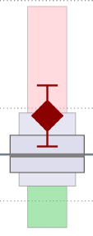
AKI Workgroup
Georgia Collaborative: ↑ AKI for all patients
9
1.61
Odds Ratio

Slide 3
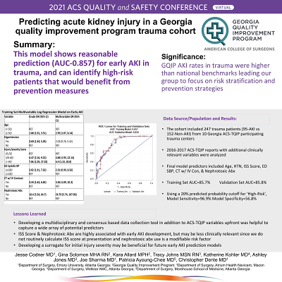
AKI Workgroup
What has group done in last 6 months?
Updating predictive algorithm: risk stratify
Based on older data (2015-2016) → update & apply
to new subset of pts retest
ISS based model→ not bedside care friendly
Updated literature search and review
Virtual poster presentation on work→
ACS Quality & Safety Conference (July 2021)

Slide 4
AKI Workgroup
What are the group’s plans/goals over next 6 months to a year?
2016 Protective Bundle Review → prevention by risk level
AKI on arrival – updated 2021 definition
Revise treatment recommendations as needed
State Data Drill Down
AKI on arrival – updated 2021 definition
GCTE Registry Sub-Committee: review updated AKI definition
Future state drill down on AKI data?
Use updated protective bundle
Monitor effectiveness of updated algorithm

