Slide 1
Pediatric TQIP
Amina M. Bhatia, MD, MS
Trauma Medical Director, Children’s at Egleston
August 12, 2021

Slide 2
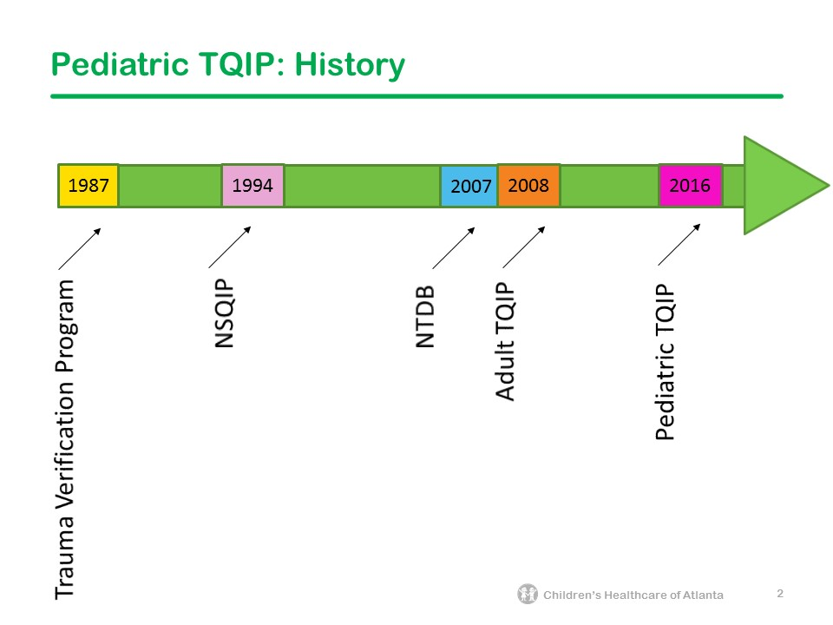

Slide 3
Objectives: Introduction to Pediatric TQIP
Introduce to you the Pediatric TQIP report
Compare & contrast the Pediatric TQIP with the Adult TQIP
Illustrate some of the value of Pediatric TQIP

Slide 4
Cohorts
Pediatric TQIP
Adult Level I/II
Pediatric TQIP population (all patients)
All, ages 0-13
All, ages 14-18
Traumatic brain injuries (TBI)
TBI, ages 0-13
TBI, ages 14-18
Splenic injuries (isolated and un-isolated)
Fracture fixation (midshaft femur and open tibial shaft)
Blunt multisystem injuries
Penetrating injuries
Severe traumatic brain injuries (sTBI)
Shock patients
Elderly patients
  blunt multisystem injuries
  Isolated hip fractures
Splenic injuries (isolated and un-isolated)
Fracture fixation (midshaft femur and open tibial shaft)
Hemorrhagic shock

Slide 5
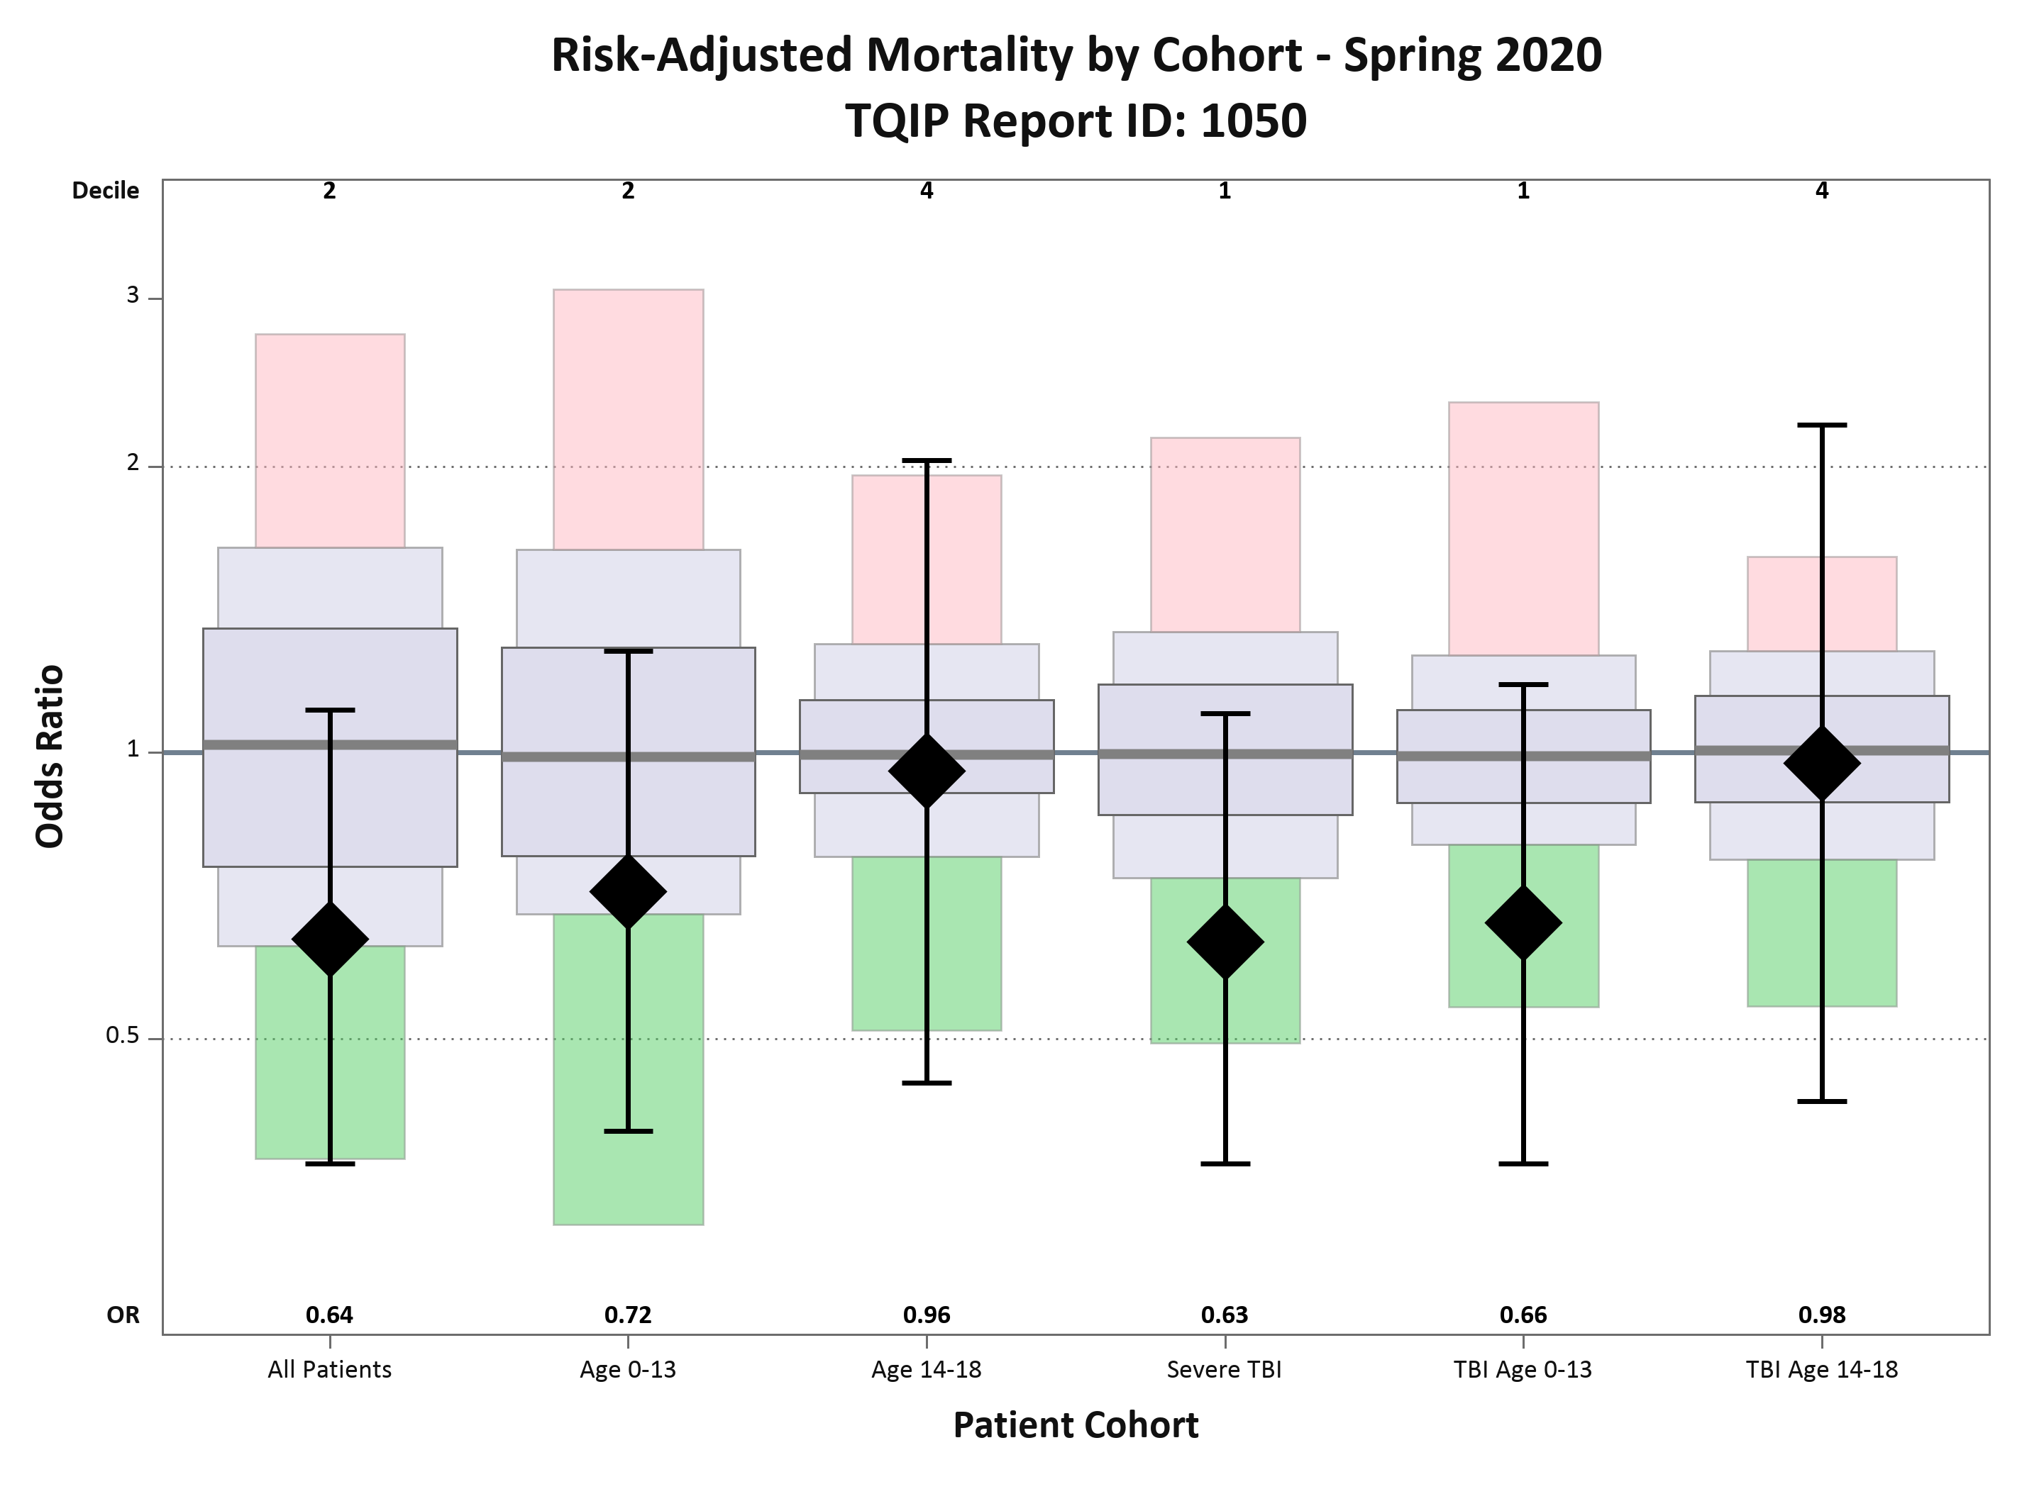

Slide 6
Modeled Outcomes
Pediatric TQIP
Adult Level I/II
Mortality
Major Complications
Major Complications ( Including Death)
Pneumonia (in TBI)
Mortality
Major Complications
Major Complications ( Including Death)
Pneumonia (in All Patients & sTBI)
AKI (In All Patients & Shock)
PE
SSI
Unplanned Return to OR
UTI
Unplanned Admission to ICU

Slide 7
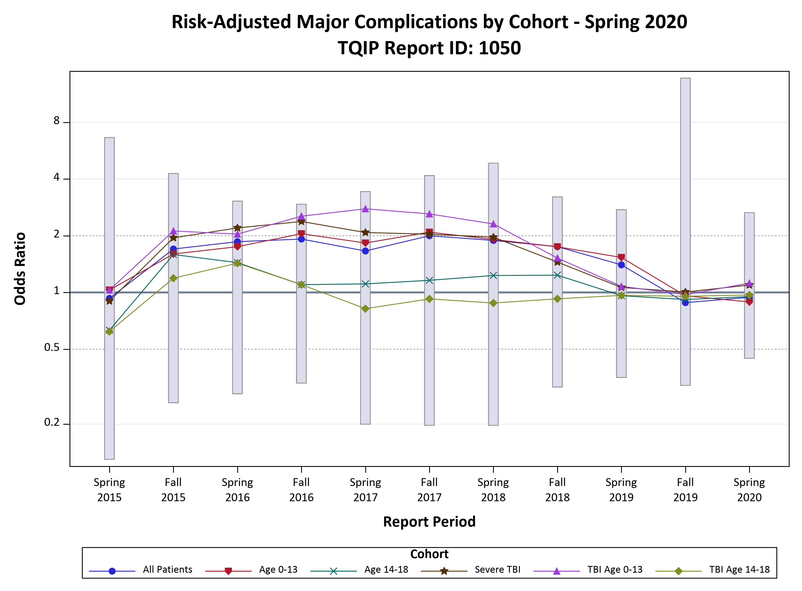

Slide 8
Summary
Pediatric TQIP
Adult Level I/II
3 major outcomes
6 Cohorts
21 models
20+ tables
4+ figures
151 centers
107,318 incidents in spring Pediatric TQIP report
3 major outcomes
8 Cohorts
33 models
30+ tables
4+ figures
850+ centers

Slide 9
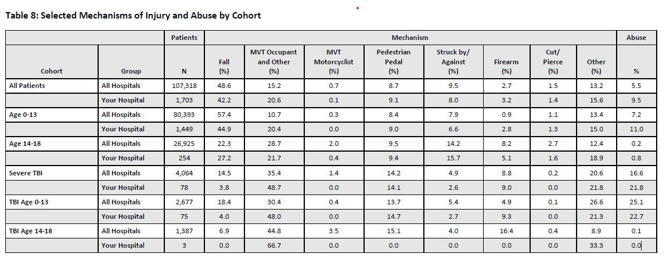

Pediatric TQIP: A snapshot of your hospital

Slide 10

Pediatric TQIP Publications
Simulation-based training is associated with lower risk-adjusted mortality in ACS pediatric TQIP centers.
Elevated pediatric age-adjusted shock-index (SIPA) in blunt solid organ injuries.
Simulation-based training for trauma resuscitation among ACS TQIP-Pediatric centers: Understanding prevalence of use, associated center characteristics, training factors, and implementation barriers.
Delta Shock Index Predicts Outcomes in Pediatric Trauma Patients Regardless of Age.
Intracranial pressure monitoring associated with increased mortality in pediatric brain injuries.
Addition of Neurological Status to Pediatric Adjusted Shock Index to Predict Early Mortality in Trauma: A Pediatric TQIP Analysis.
Early Tracheostomy for Severe Pediatric Traumatic Brain Injury is Associated with Reduced Intensive Care Unit Length of Stay and Total Ventilator Days.
The survival benefit of low molecular weight heparin over unfractionated heparin in pediatric trauma patients.
Risk factors associated with splenectomy following a blunt splenic injury in pediatric patients.
Helicopter transport in pediatric trauma: A new methodology using Need for Surgeon Presence to evaluate the necessity of air transport.
Validation of the age-adjusted shock index using pediatric trauma quality improvement program data.
Outcomes after resection versus non-resection management of penetrating grade III and IV pancreatic injury: A trauma quality improvement (TQIP) databank analysis.
The effects of smoking on adolescent trauma patients: a propensity-score-matched analysis.
Whole Blood Hemostatic Resuscitation in Pediatric Trauma: A Nationwide Propensity-Matched Analysis.
The Effects of Body Mass Index and Seatbelt Use on Pediatric Chest and Abdominal Injuries after Motor Vehicle Collisions.

Slide 11

Amina.Bhatia@choa.org

