Slide 1
GQIP Collaborative Report TBI Workgroup Drilldown Exercise
Elizabeth R Benjamin MD PhD FACS
Day of Trauma August 13, 2021
St Simmons Island, GA

Slide 2
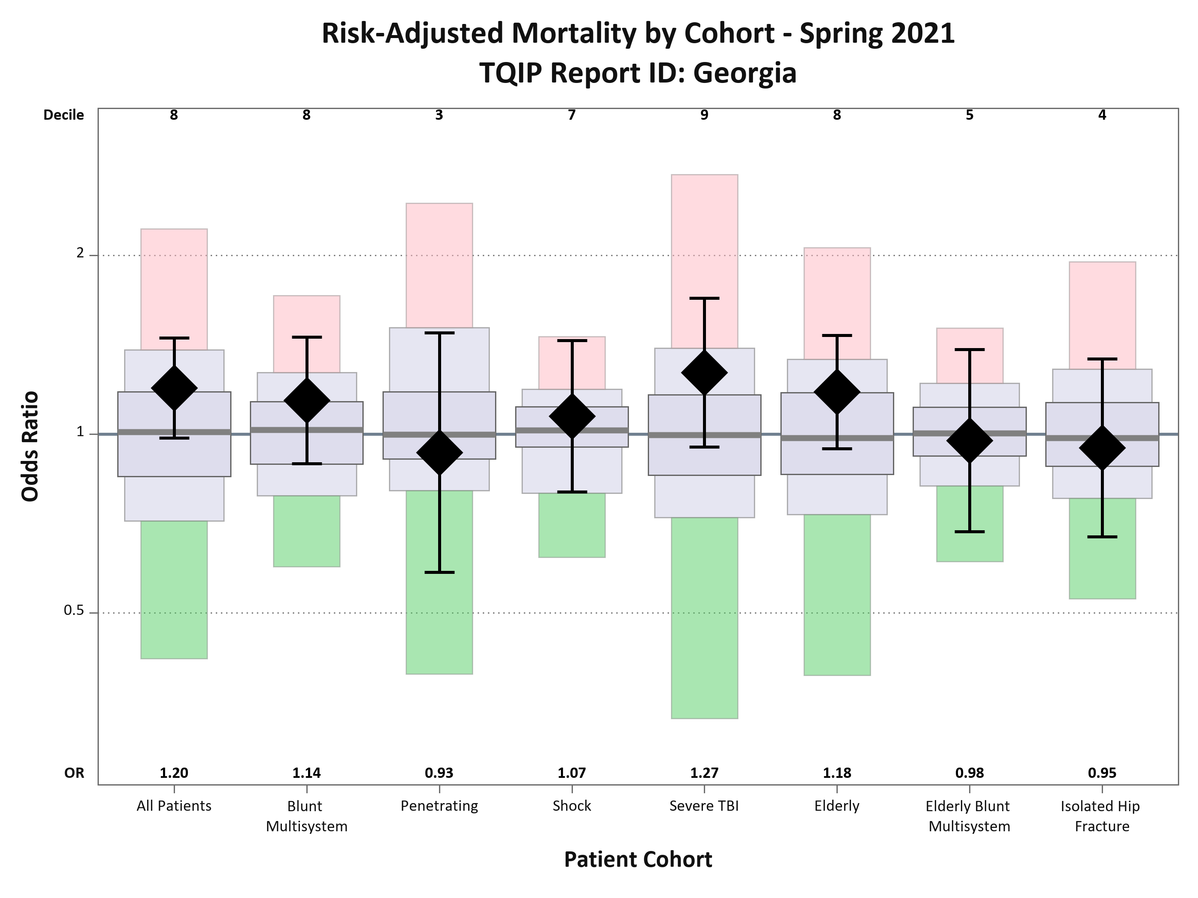
Collaborative Report - Mortality
DECILE
8
8
3
7
9
8
5
4

Slide 3
Collaborative Report - Mortality
DECILE
8
8
3
7
9
8
5
4
GA Specific Data
Opportunities
Severe TBI cohort

Slide 4
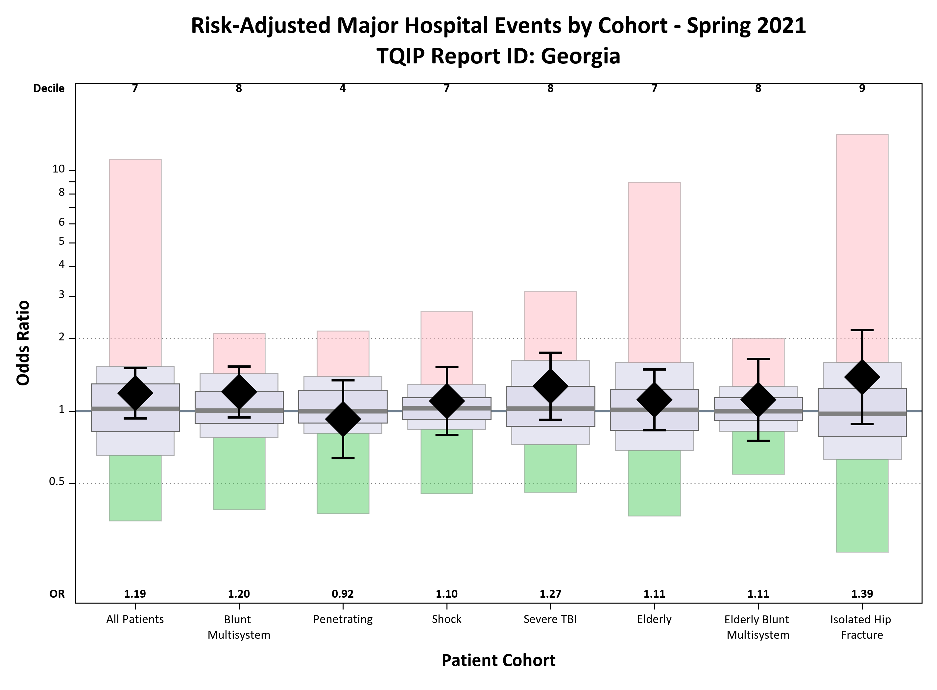
Collaborative Report - Morbidity
DECILE
7
8
4
7
8
7
8
9
GA Specific Data
Opportunities
Severe TBI cohort

Slide 5
Collaborative Report
TBI identified as a cohort with opportunity for improvement
Developed a workgroup to address TBI care in GA
Contribution from 94% Level I, Level II, and Pediatric Trauma centers in the state
Diversity of participants
TPMs, PI nurses, Trauma Surgeons, Neurosurgeon
Drilldown development plan

Slide 6
Drilldown Exercise: TBI
Stage 1
Identify key target areas with opportunity for improvement
Drilldown of patient population with low probably of adverse outcomes that had adverse outcome
Drilldown of patient population with high probability of adverse outcomes that did not have adverse outcome
What are the determinants of probability?
What are our biggest areas for improvement?
Stage 2
Drilldown key target populations
Address high yield adverse events
Stage 3
Guideline development
State advocacy
Notes:
Spent some time talking about the challenges we face with TBI patients…

Slide 7
TQIP Probability of Event
Event: Mortality or Major Complication
(Survival > 2 days)
Mortality
AKI
ARDS
Cardiac Arrest
CLABSI
Deep SSI
MI
Organ space SSI
Pressure Ulcer
PE
Severe Sepsis
CVA
Unplanned OR
VAP

Slide 8
TQIP Probability of Event
30%
70%
Probability of Event
Low Probability
Major Event
High Probability
No Major Event

Slide 9
TQIP Probability of Event
What are the TQIP determinants of probability?
Covariate | 30% Probability of Event (n=71) | 70% Probability of Event (n=46) | p-value
Age (yrs) | 30 (21-51) | 55 (30-74) | <.001
Initial GCS Total | 4 (3-7) | 3 (3-6) | 0.028
AIS Head | 3.79 ± 0.70 | 4.76 ± 0.52 | <.001
ISS | 24 (17-29) | 29 (26-42) | <.001
ICP Monitor | 27 (46.6%) | 10 (23.8%) | 0.020
Craniectomy | 15 (22.4%) | 20 (43.5%) | 0.046
ICU days | 13 (9-27) | 11.5 (7-24) | 0.517
Ventilator days | 11 (5-14) | 9 (3-20) | 0.753
Hospital LOS | 15 (6-38) | 27 (10-37) | 0.214
Notes:
Age, GCS, degree of injury likely play a large role in probability
Low GCS even with low probability
Interestingly, our HLOS is long – left column includes deaths – even those without event stay nearly 4 weeks

Slide 10
Low Probability Cohort: Mortality
Covariate | Survival (N=41) | Mortality (N=30) | p-value
Age (yrs) | 30 (20-51) | 27 (21-41) | 0.958
Initial GCS Total | 4.9 ± 1.9 | 5.2 ± 2.6 | 0.594
AIS Head | 3.71 ± 0.7 | 3.9 ± 0.7 | 0.255
ISS | 22.8 ± 8.3 | 27.4 ± 10.3 | 0.051
Admit Service Trauma Neurosurgery | 35 (85.4%) 3 (7.3%) | 26 (86.7%) 1 (3.3%) | 0.761
ICP Monitor | 16 (42.1%) | 11 (55.0%) | 0.349
Craniectomy | 9 (22.5%) | 6 (22.2%) | 0.471
Hospital LOS | 29 (15-49) | 4.5 (2-12) | <0.001
Withdrawal of Care | 3 (7.3%) | 12 (42.3%) | 0.009
Notes:
Looked at the breakdown of who died and who survived – populaitons were actually quite similar – overall injury burden likely a bit higher in those that died but similar degree of head injury and intervention
Two interesting points were the short HLOS in those that died of only 4.5 days and the high percentage of patients in which there was a withdrawl of care.
Look into this population more…

Slide 11
Low Probability Cohort: Events
Complication | n=71
Mortality | 30 (42.3%)
AKI | 5 (7.0%)
ARDS | 7 (9.9%)
Alcohol Withdrawal | 0
Cardiac Arrest | 8 (11.3%)
CAUTI | 1 (1.4%)
CLABSI | 1 (1.4%)
Deep Venous Thrombosis | 1 (1.4%)
Delirium | 0
Compartment Syndrome | 0
Myocardial Infarction | 0
Osteomylitis | 0
Complication | n=71
Pulmonary Embolism | 5 (7.0%)
Pressure Ulcer | 11 (15.5%)
Sepsis | 3 (4.2%)
Surgical Site Infection | 1 (1.4%)
Unplanned ICU Admission | 7 (9.9%)
Unplanned Intubation | 7 (9.9%)
Unplanned Trip to Operating Room | 1 (1.4%)
VAP | 19 (26.8%)
Withdrawal of Care | 15 (21.1%)
Palliative Care | 19 (28.4%)
Notes:
In our low probability group, over 40% dies. The two other complications that pulled out as common were VAPs and pressure ulcers

Slide 12
Low Probability Cohort: Events (excluding mortality)
Complication | n=41
AKI | 2 (4.9%)
ARDS | 3 (7.3%)
Cardiac Arrest | 3 (7.3%)
CAUTI | 1 (2.4%)
CLABSI | 0
Deep Venous Thrombosis | 2 (4.9%)
Pulmonary Embolism | 5 (7.0%)
Pressure Ulcer | 9 (22.0%)
Sepsis | 1 (2.4%)
Complication | n=41
Surgical Site Infection | 1 (2.4%)
Unplanned ICU Admission | 5 (12.2%)
Unplanned Intubation | 4 (9.8%)
Unplanned OR | 1 (2.4%)
VAP | 18 (43.9%)
Withdrawal of Care | 3 (7.3%)
Notes:
When you look at just those that lived, this is even more prominent

Slide 13
Low Probability Cohort: VAP (excluding mortality)
 | VAP (n=18) | NO VAP (n=23) | p value
Age | 34 | 34 | 0.935
GCS | 4.7 | 5.1 | 0.482
ED LOS | 286 min | 187 min | 0.061
AIS Head | 3.8 | 3.7 | 0.405
AIS Chest | 2.9 | 2.0 | 0.034
ICU LOS | 21 | 24 | 0.439
Vent Days | 16 | 18 | 0.474
HLOS | 33 | 42 | 0.428
Days to Trach | 15 | 15 | 0.995

Slide 14
Low Probability Cohort: Disposition
Discharge Disposition | Total | Hospital LOS (days)
Expired | 32 (45%) | 4.5 (2.5-11.5)
Inpatient Rehab | 34 (48%) | 24 (14-43)
Home with No Services | 20 (28%) | 21 (8.5-34)
Long Term Acute Care | 12 (17%) | 28 (20-33)
Skilled Nursing Facility | 7 (10%) | 31 (24-37)
Hospice Care | 7 (10%) | 15 (13-32)
Other | 4 (6%)

Slide 15
Summary and Next Steps
What are the drivers of mortality after severe TBI?
Early mortality (4.5 days)
Is there a way to more effectively serve patients who progress to withdrawl of care?
What are the driving forces for developing VAP?
Targets for VAP mitigation
What can we do to address our high rates of pressure ulcer formation?
Extended HLOS in the severe TBI population
What are the barriers to progression through hospital stay
What are the barriers to discharge

Slide 16
ebenja2@emory.edu

