Slide 1
Spring 2021 TQIP Collaborative Report
Dr. Christopher Dente

Slide 2
Spring 2021 TQIP Collaborative Report
Report based on data from October 2019 through September 2020
Total NTDB Inclusion Patients: 26,702
Total TQIP Inclusion Records: 12,969
Percent TQIP Records: 48.5%
Notes:
This report was based on data that is, in some cases basically two years old. TQIP included about half of the registry patients that were submitted, which is a pretty standard scenario

Slide 3
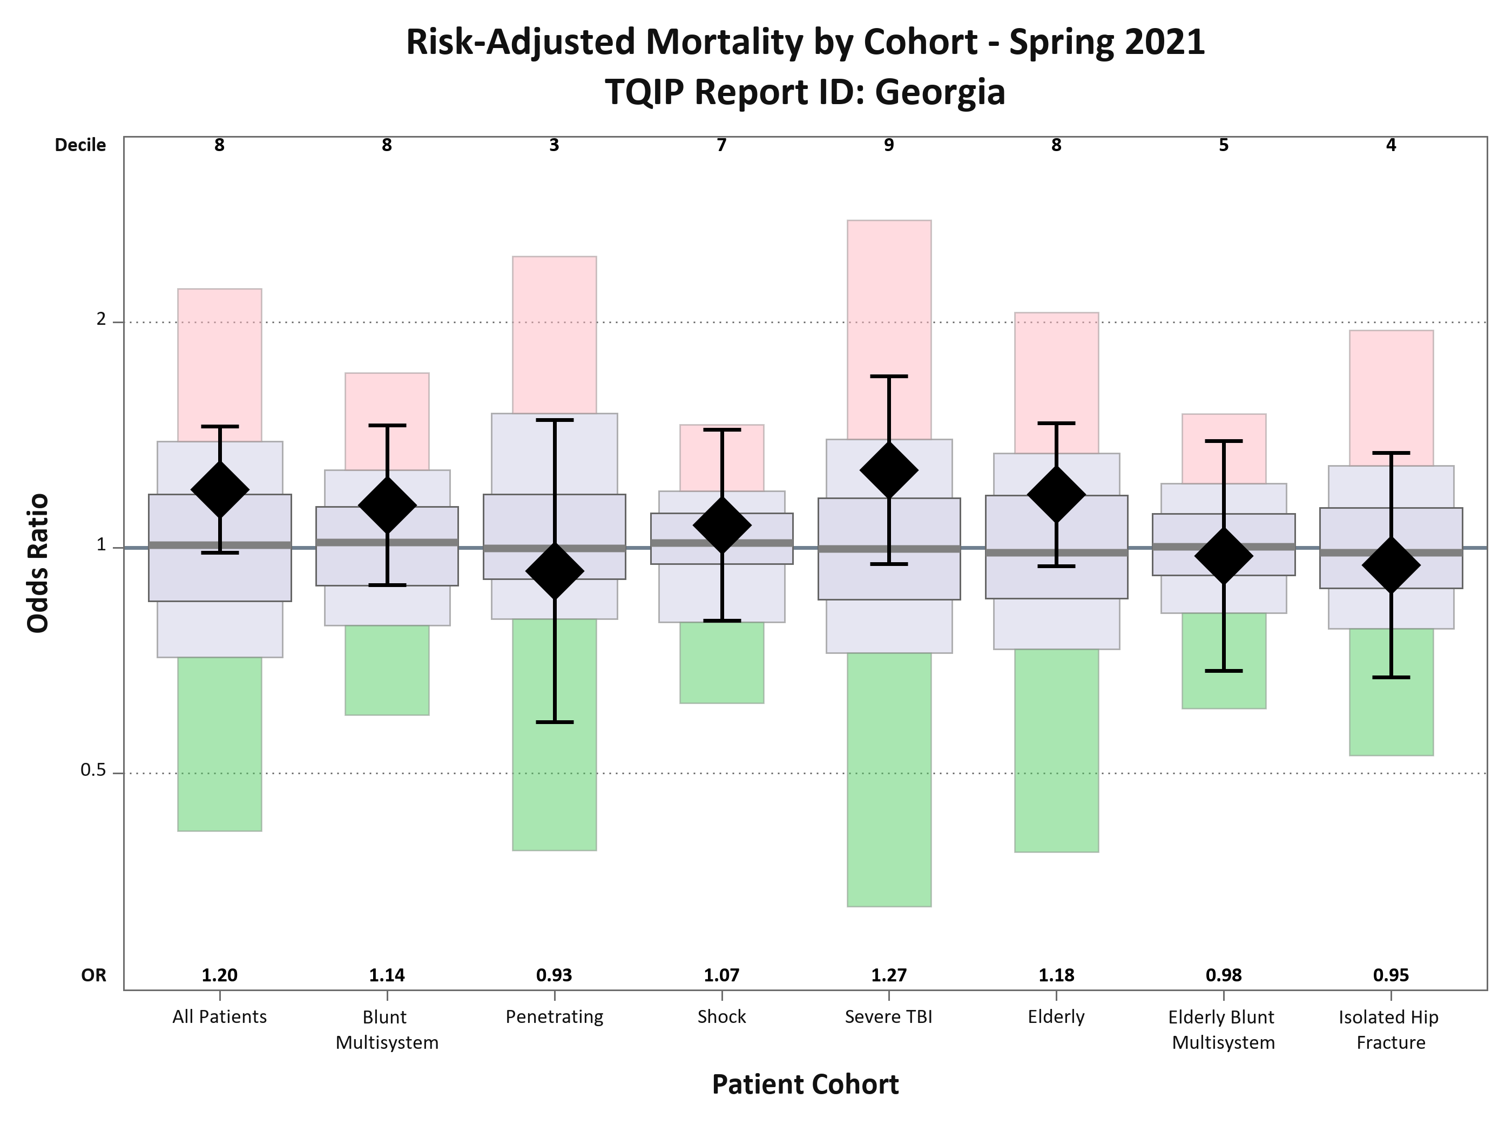
Risk Adjusted Mortality
Notes:
This is what our risk adjusted mortality looked like…average across the board and our deciles, as a group have also fallen…so no bad news here.

Slide 4
Risk Adjusted Mortality Over Time
Notes:
OR good across the board

Slide 5
Compared to 5 years ago……….

Slide 6
Risk Adjusted Mortality Over Time

Slide 7
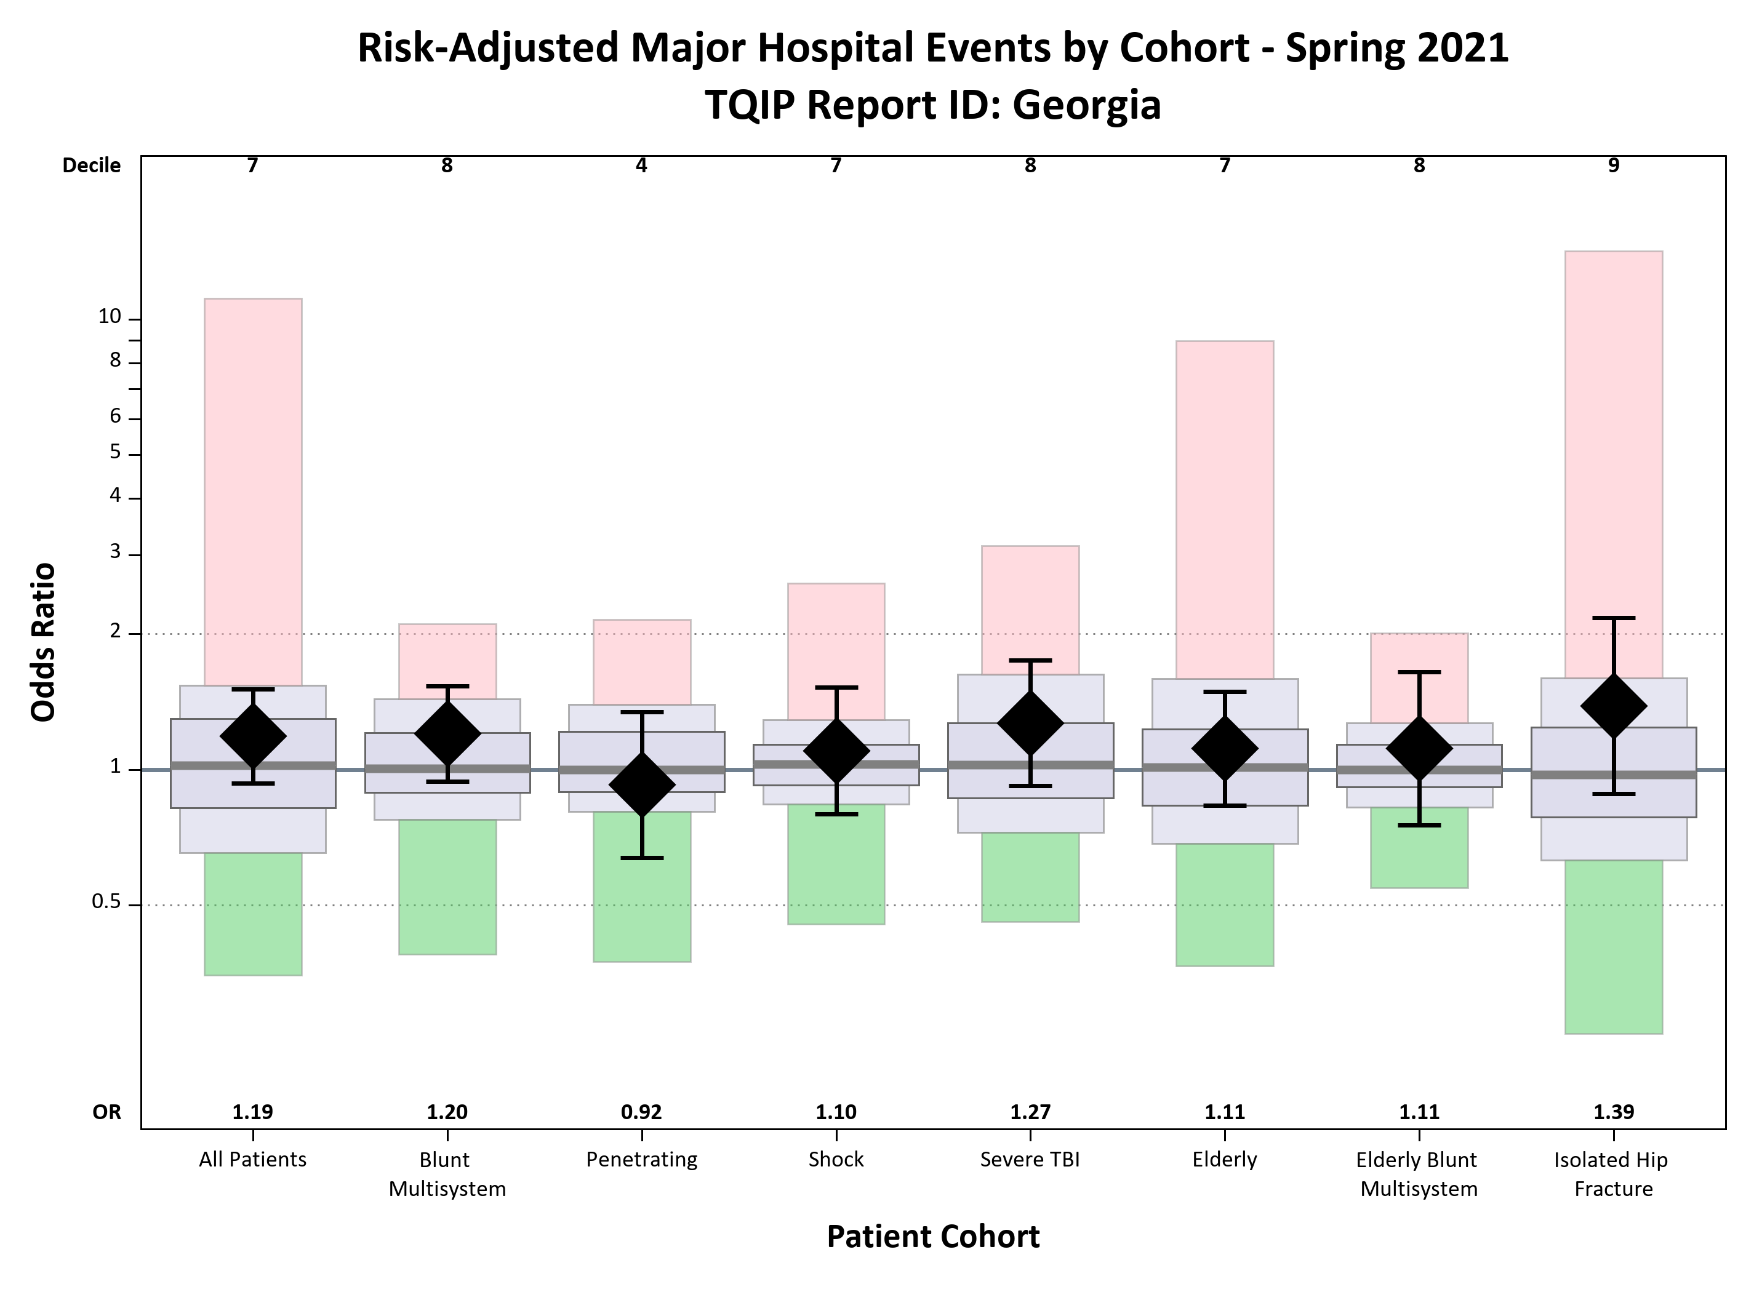
Risk Adjusted Major Hospital Events
Notes:
Complications or MHE look much better too. The red is almost totally gone from this slide as well.

Slide 8
Risk Adjusted Hospital Events Over Time

Slide 9
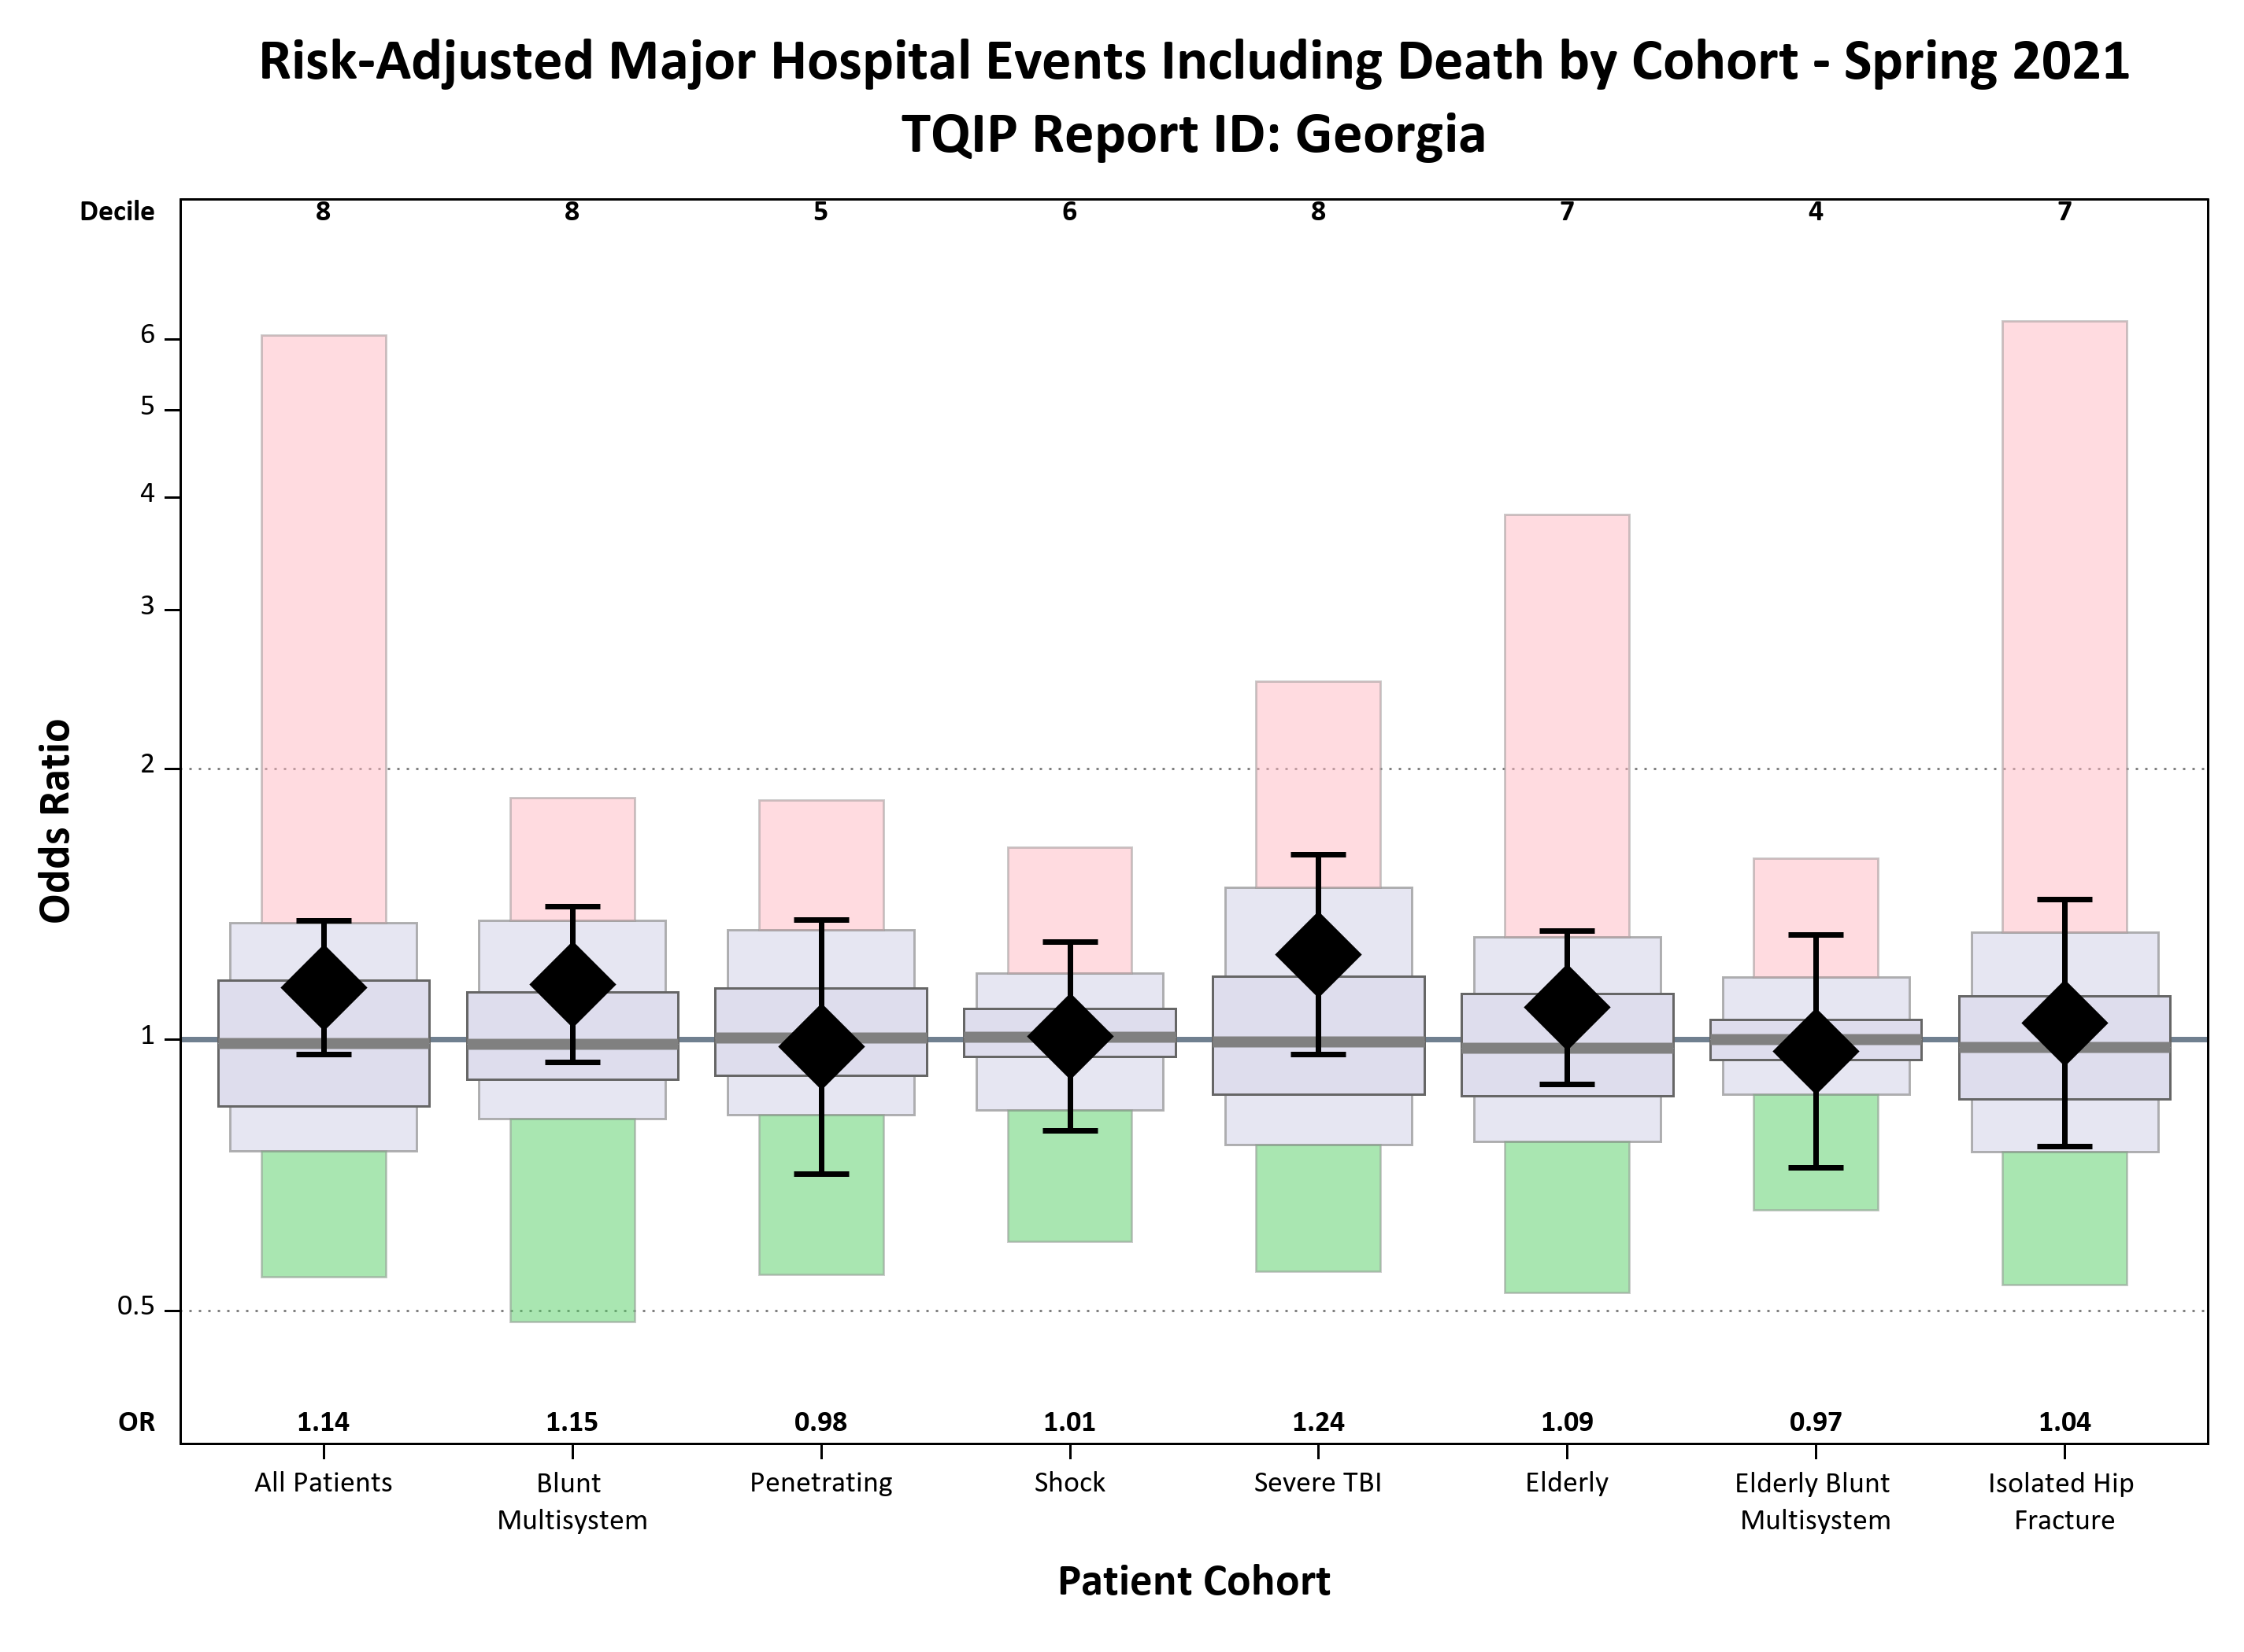
Risk Adjusted Major Hospital Events Including Death

Slide 10
Risk Adjusted Major Events Including Death Over Time

Slide 11
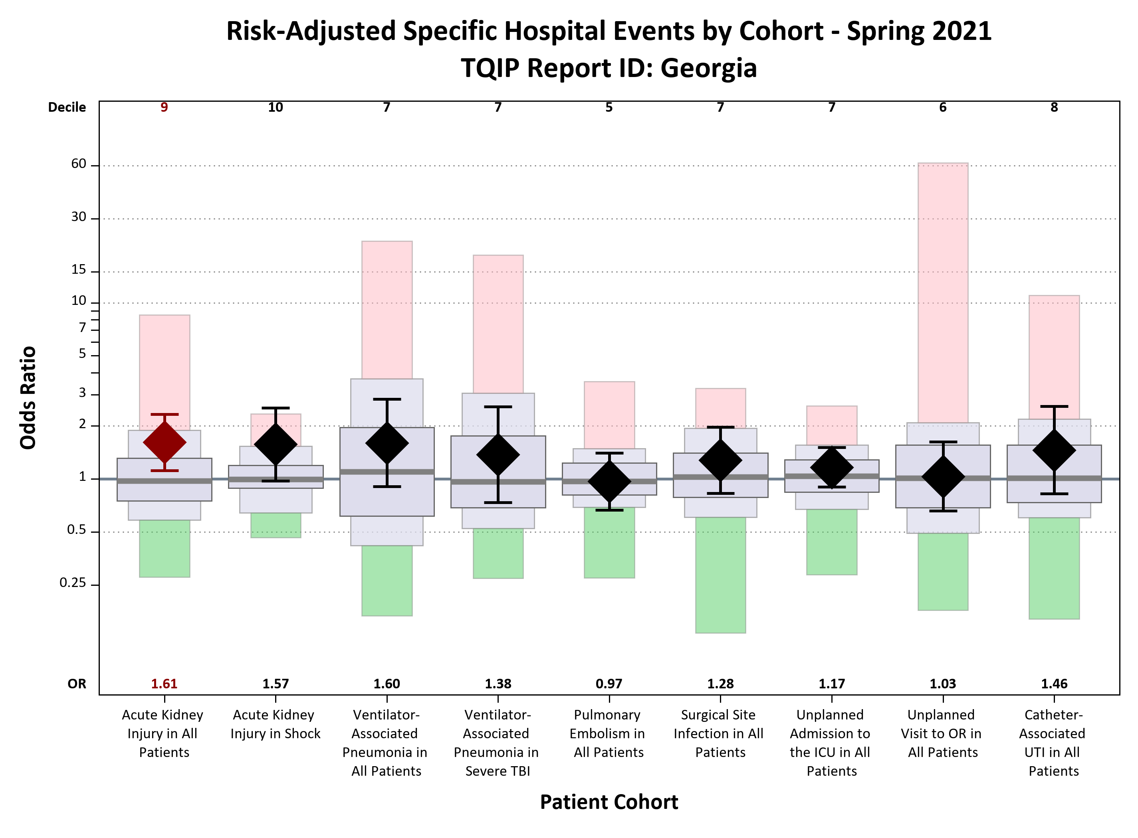
Risk Adjusted Specific Hospital Events

Slide 12
Risk Adjusted Specific Events Over Time

Slide 13
Patient Characteristics & Processes of Care
Consistent with TQIP Averages:
LOS, ICU Utilization & Mechanical Ventilation Days
Time to First Operative Fixation Isolated Hip and Mid-Shaft Femur
Operative Management of Blunt Splenic Injuries
Cerebral Monitoring for Severe TBI Patients
Time to Tracheostomy for TBI Patients
Angiography for Hemorrhagic Shock Patients
Plasma to Packed Red Blood Cells Ratios for Hemorrhagic Shock Patients
Percent of Deaths

Slide 14
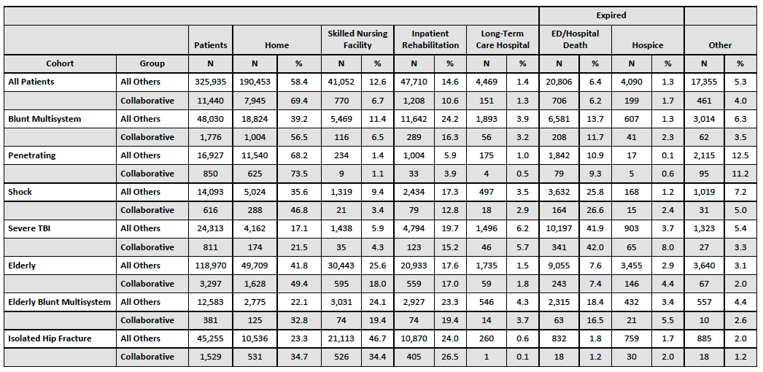
Discharge Disposition by Cohort

Slide 15
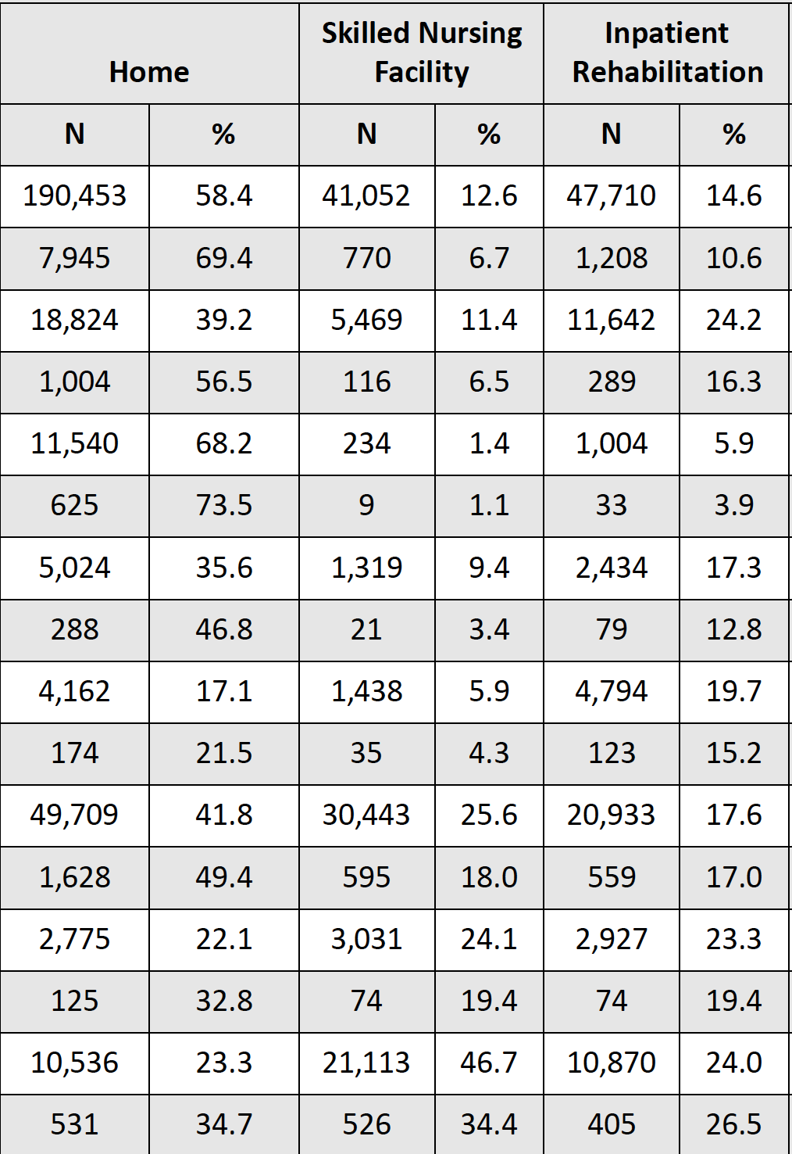
Discharge Disposition by Cohort

Slide 16
Summary
Slowly Improving TQIP state report
No large red flags or significant concerns
AKI is a persistent problem
We underutilize Acute Rehab and LTAC
The projects that we are developing address some of the things we are seeing in our reports but the reports themselves seem confining…

