Slide 1
GGQ TQIP Level III Benchmark Report
Kelli Vaughn RN, MSN, CEN
John D. Archbold Memorial Hospital

Slide 2
TQIP Benchmark Report Differences
TQIP Collaborative report excludes Level 3’s
Inclusion Criteria
Risk adjusted modeling
Includes v/s, specific diagnoses, varied interactions for Level 3’s
Level 1 and Level 2 | Level 3
Age > 16 | All ages
ISS > 9 | ISS > 4
Excludes transfers from the ED | Includes transfers from the ED

Slide 3
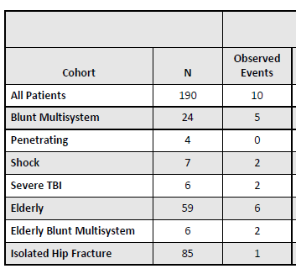
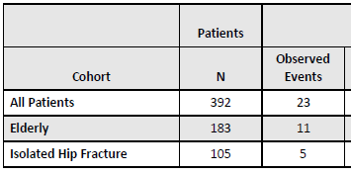
TQIP Benchmark Report Differences
Cohort differences
Mortality and Major Hospital events
Level 1 & Level 2 Level 3

Slide 4
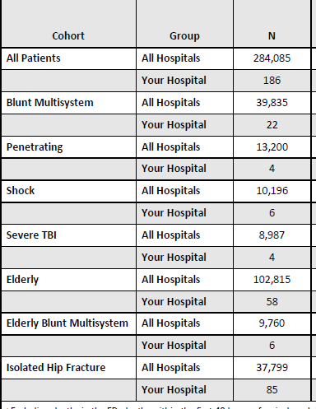
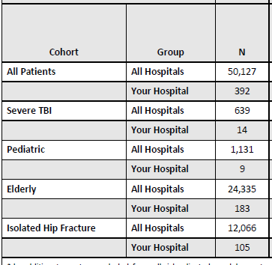
TQIP Benchmark Report Differences
Processes of Care Measures
Cohorts for Hospital Events and Pre-existing Conditions
Level 1 & Level 2 Level 3

Slide 5
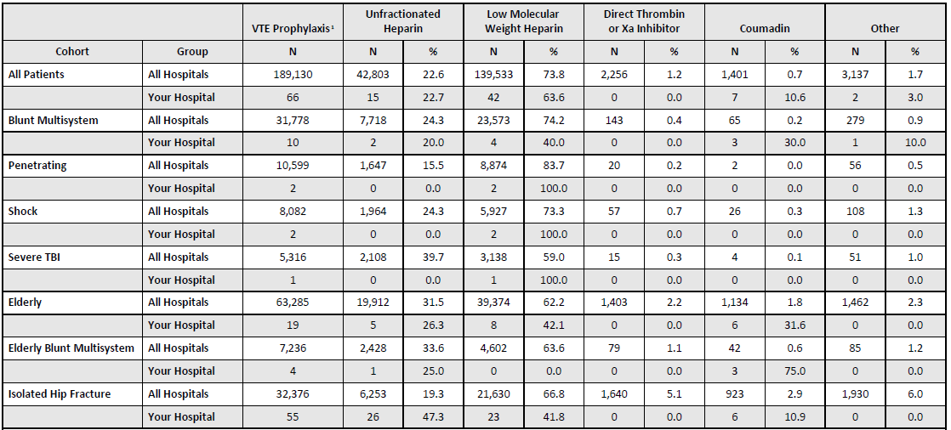
TQIP Benchmark Report Differences
Processes of Care Tables
Level 1 and Level 2
Spleen procedures
Pharmacologic VTE Prophylaxis
Trach management for TBI
Hemorrhagic Shock
Transfusion volume
Withdrawal of care
Time to death
Level 3
Time to Transfer

Slide 6
TQIP Benchmark Report Differences
In summary
No state comparison
Different inclusion criteria
Decreased number of cohorts
Less Performance measures

